Slide 1
Improving feedback participation by distance learners
Presentation by Dr Tim Young Senior Teaching Fellow
Institute of Neurology/UCL Distance Learning Clinical Neurology MSc/Diploma Course

Slide 2
The challenge to feedback engagement on our course
Obtaining sufficient student feedback can be challenging, especially on distance learning courses.
We have nearly 100 students worldwide on our distance learning clinical neurology course.
All our students are busy practicing doctors, an additional potential barrier to engagement.

Slide 3
Developing approaches to improve student participation 1
Our large distance learning course in clinical neurology has a monthly activity for which submissions are strongly advised.
Unlike our formal exams, we have been trying to allow some flexibility to students with participation
with these monthly activities. Unfortunately this has led to low engagement.
Rather than the drastic step of simply awarding zero for any month without a submission,
we hoped to preserve the excellent atmosphere and ‘community of learners’ we have on our course.
We therefore sought to incentivise students to submit answers to the monthly activity

Slide 4
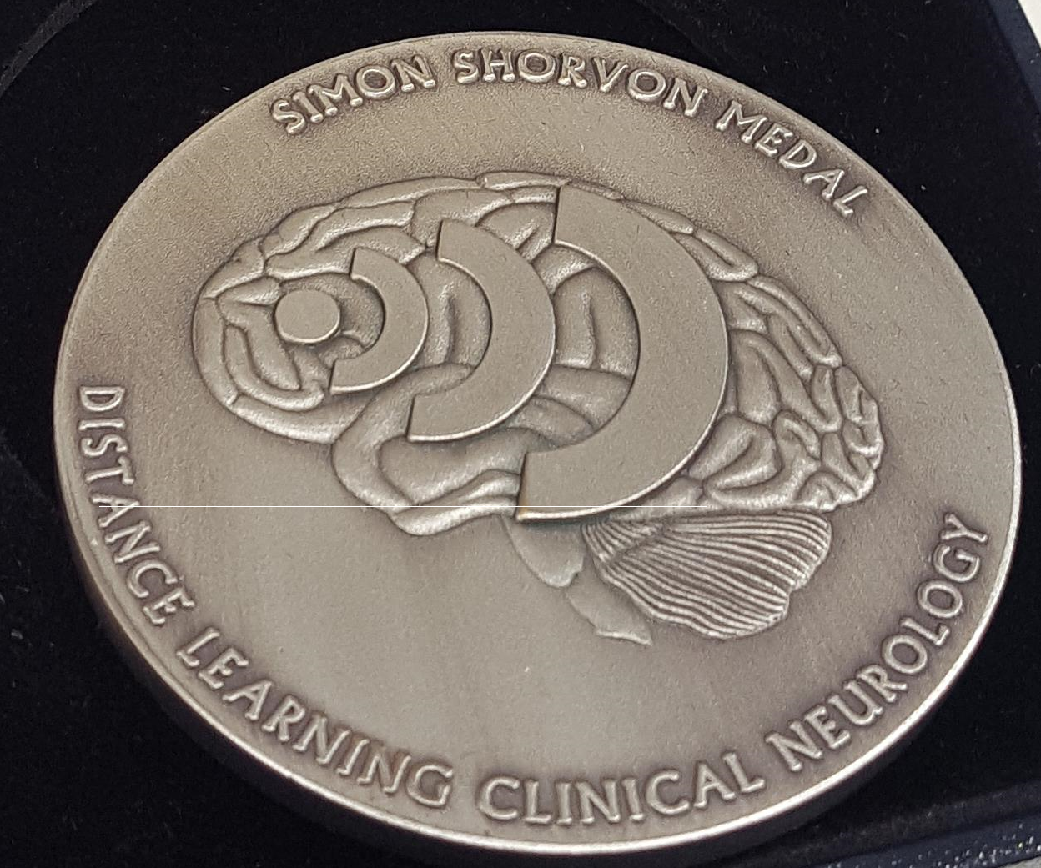
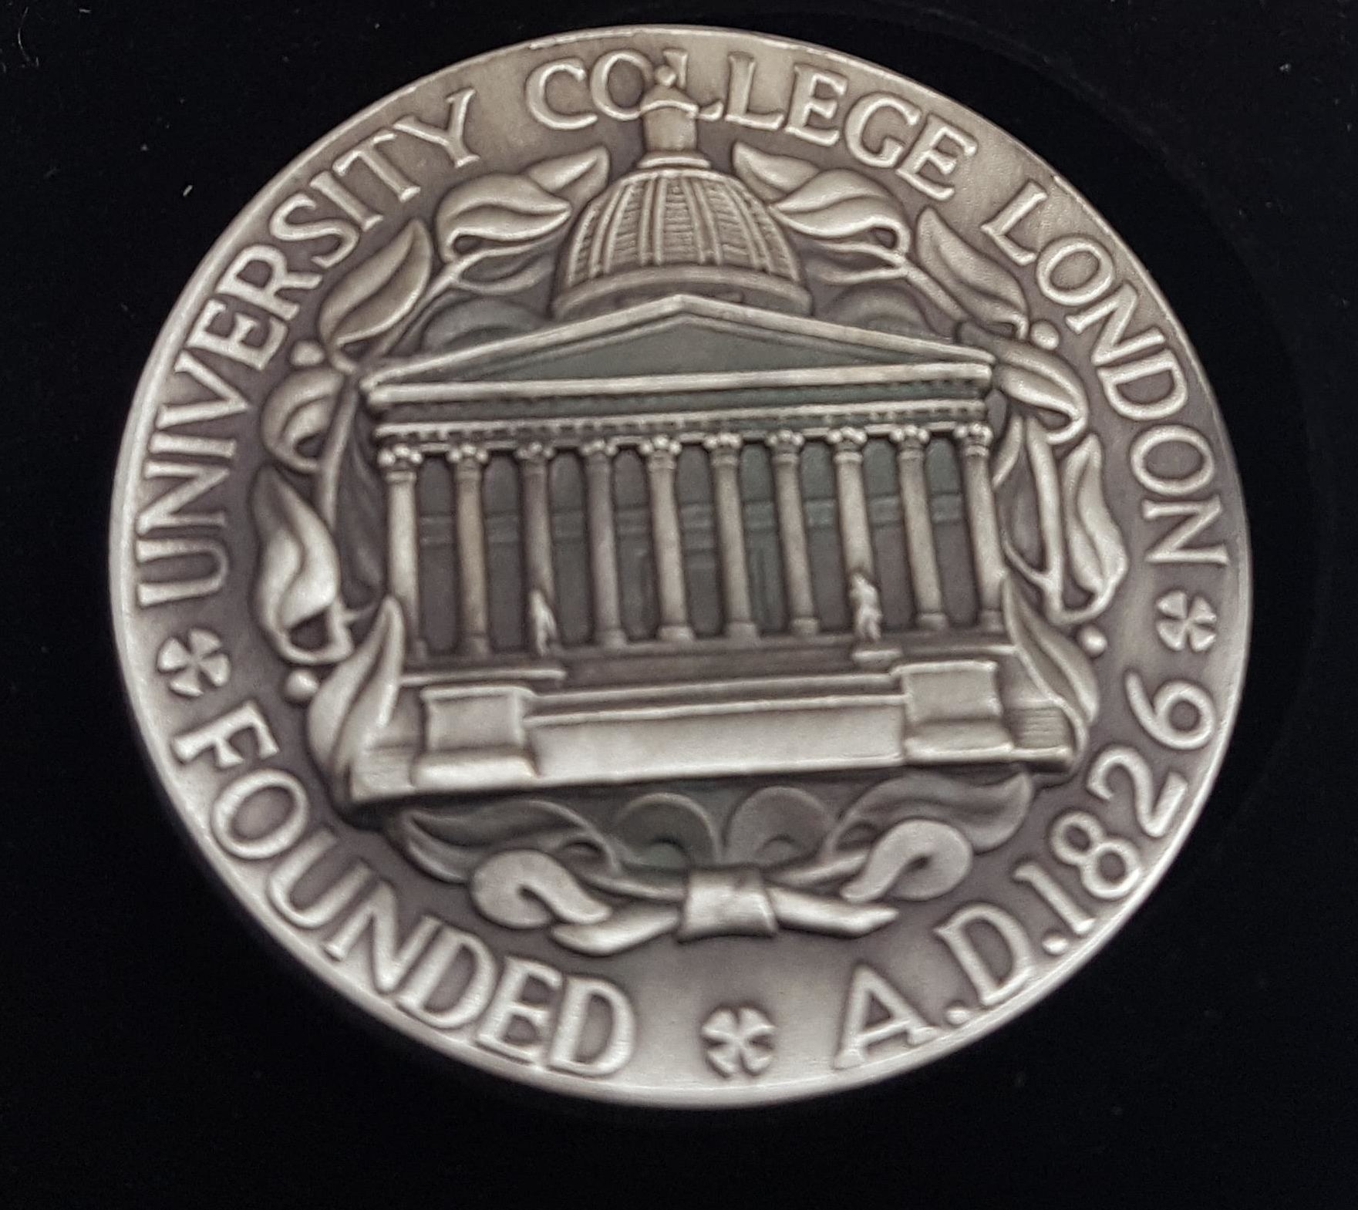
Developing approaches to improve student participation 2
Incentives for the monthly activities included:
A) Money-a £100 prize for the student with the best submissions over the year:
Outcome: NO improvement in participation rates.
B) Medal-the first medal for the course was designed with monthly submissions a significant factor
Outcome: Significant improvement in participation rates.
Feedback from the students then indicated that the very individualised feedback provided by these activities was rated as the best part, not only for the activities but for our whole course.
Students felt ‘respected’ and valued by the individualised feedback and this inspired them.

Slide 5
Postgraduate Taught Experience Survey (PTES)
The Postgraduate Taught Experience Survey (PTES) is a Higher Education Academy (HEA) development tool.
Running sine 2009, the PTES has been described as “the main source of information about students’ motivations”*
Despite the great potential of this survey, student participation tends to be low nationally (29% in 2018).
Previously, as with other distance learning courses, our student participation was even more challenging (14% in 2017).
We sought to improve the 2018 PTES participation rates for our large distance learning course.
This was important to have confidence that the results were truly representative, aiming for >50% participation.
*Adrian Smith One Step Beyond Department of Business, Innovation and Skills report March 2010, p. 37

Slide 6
Methods Used to improve PTES response rates
Existing Methods: Generic emailing of all students via Course Forum posts, offering a chance to win Amazon vouchers and generic emails prefaced by the student’s individual Name.
Despite such attempts, student participation with PTES on our course was very low-9% for 2016 and 14% for 2017.
New Methods: Building on the experience of the highly individualised approach adopted in our monthly activities, I reasoned that a similar technique could raise PTES participation enough to make the results representative.
My approach involved a ‘piggy-back’ method. Specifically providing some information relevant to each individual student as part of the same email to request participation in the PTES survey.
I periodically provide each student this type of personal feedback at several points in the year anyway.
The difference was to piggy-back my feedback and guidance together with a request to the student to provide us with course feedback and guidance. I stressed that we wanted to hear even negative views about the course so that we could try and rectify this.

Slide 7
Results 1
2018 PTES response rate for our course of 68%, including a 47% increase in responses from BME students compared to 2017.
For the first time on our course, at over 50%, the feedback was representative. The PTES response nationally was 29% in 2018.
The PTES feedback results included further very clear appreciation from our students of the individualised approach (viewed as the best thing about the course by the large majority of respondents).
Also it became clear that the explanation of the criteria used in marking on our course was not totally clear to all students. This was promptly rectified as a result, with increased clarity in our communications including an email to every student outlining this.

Slide 8
Results 2
We believe that truly individualised student interaction makes them feel valued and far more likely to respond than by trying to save time with quick generic postings. This is especially important when activity is required from the student, such as work submissions or survey participation. Although it was certainly a more time consuming method (I was the only tutor performing this activity in 2018), the facts that we finally had meaningful PTES results certainly made it worth while.
It could be argued that giving anything for a response could influence the response itself. However, the piggy-backed feedback I offered was actually developing the same lines of guidance I had already offered at other time points in the year. By showing the students that we respect and value them it is far more likely that they will feel empowered to share their views.

Slide 9
Thank you, and thanks also to our Clinical Neurology by Distance Learning team at the Institute of Neurolgy, Queen Square, UCL, London
Any Questions?

