Slide 1
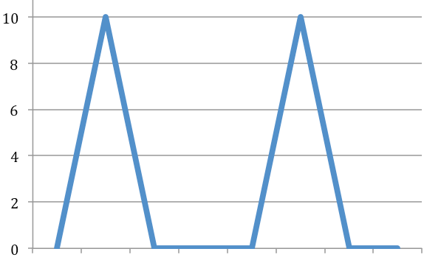
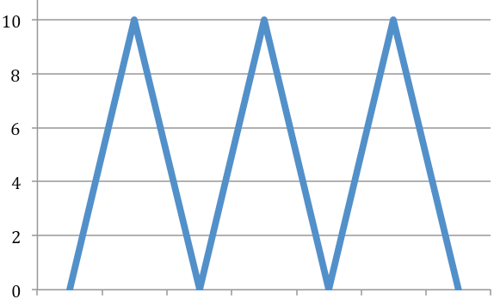
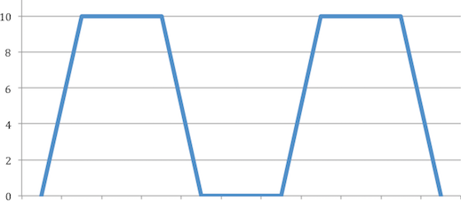
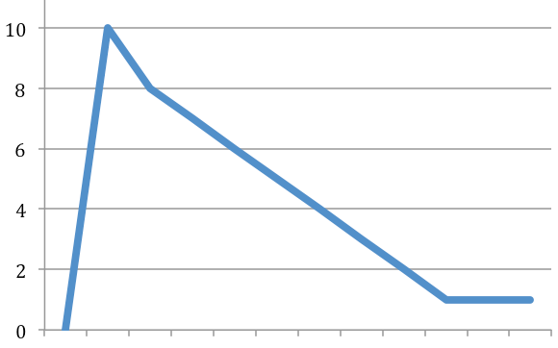
1
3
Seconds
Minutes
Seconds
2
4
Seconds
Minutes
Hours
Seconds
Minutes
Notes:
Figure 1 Timing of attacks
X axis : severity on a scale of 0-10 , can vary in severity
Y axis time

Slide 2





Pain
Clinic
Oral
surgery
Oral
medicine
Neurology
Neurosurgery
Headache neurology
Specialist facial pain
Notes:
Figure 2. Pathways of referral for patients with trigeminal neuralgia

Slide 3
Trigeminal neuralgia pathway : UCLH
      Primary care NICE Carbamazepine
      Initial good control but now failing
      Refer secondary care
Phenotyping by physicians
Questionnaires - PROMS
MRI
Symptomatic TN
Pain free
Drug therapy
Monitor PROMS
Out patient appointments with physician/clinical nurse specialists
MS
Tumours etc
Neurosurgery
Joint neurosurgery clinic
Facial Pain Psychology
Microvascular decompression Ablative Gasserian ganglion
Gamma knife
TN Pain Management Programme
Complications and/or recurrences
Pain free
Discharge to primary care

