Slide 1
Figure 1

Slide 2
Figure 2
a
b
c

Slide 3
A tandem quadruplex formed from all-parallel monomers
A tandem quadruplex formed from hybrid monomers
Figures for Box 1

Slide 4
DR4-47
Di-Ni-salphen
Figures for Box 1

Slide 5
a
b
c
Figure 3

Slide 6
d
Figure 3

Slide 7
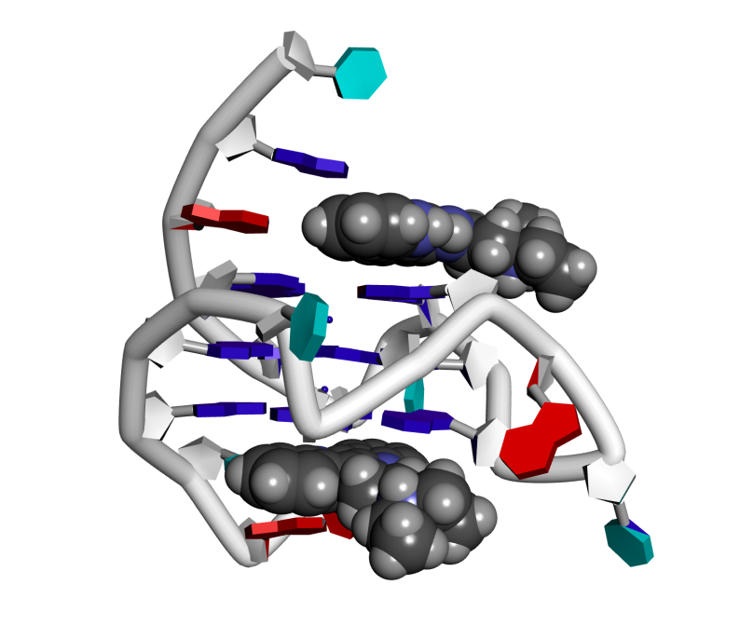
Figures for Box 3
b
a

Slide 8
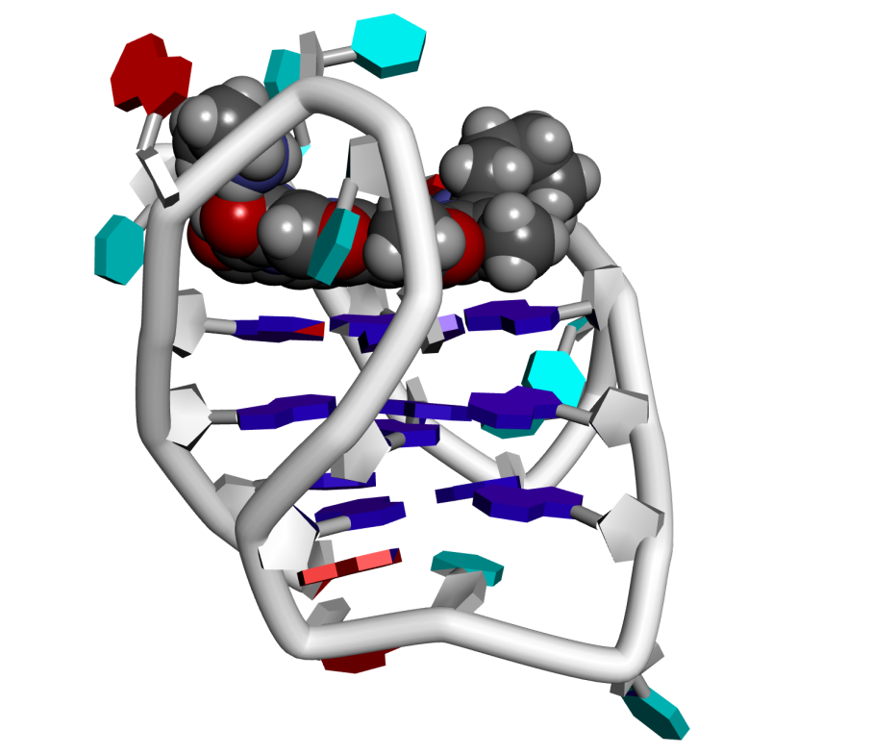
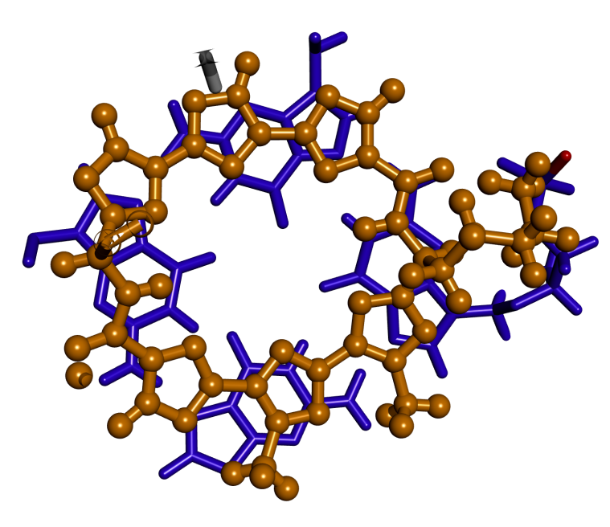
Figures for Box 3
c
d
e

Slide 9
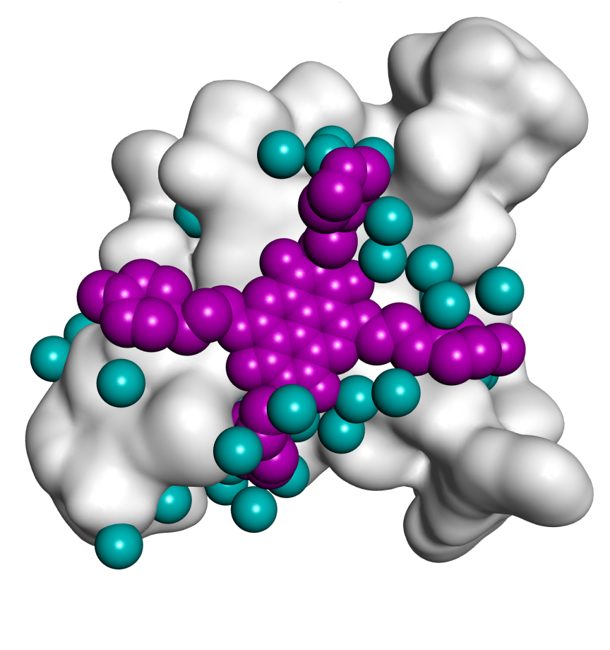
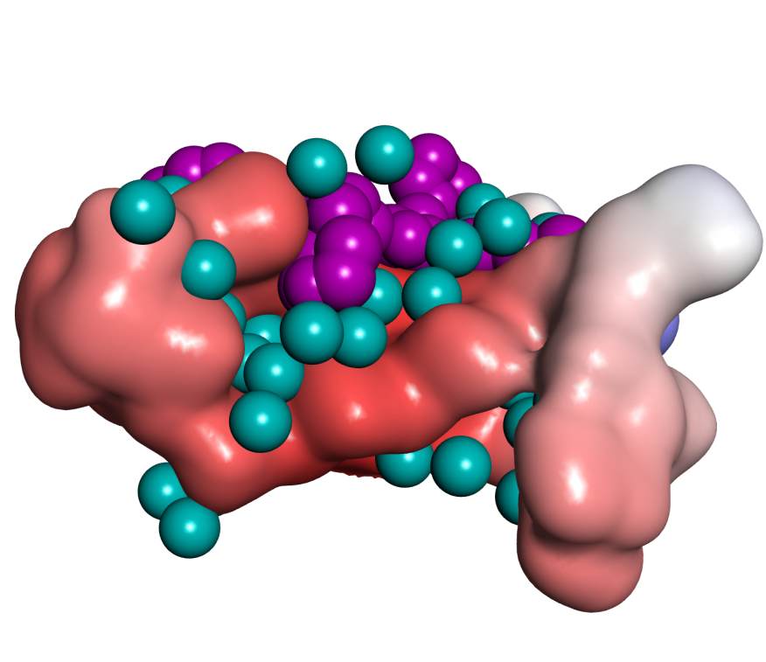
h
f
g

Slide 10
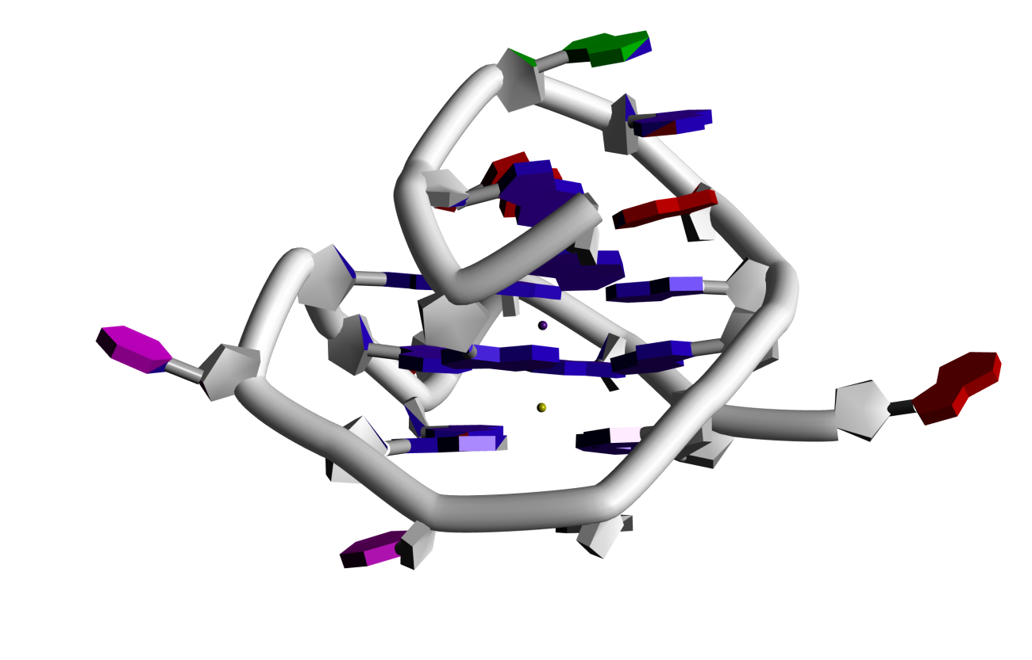
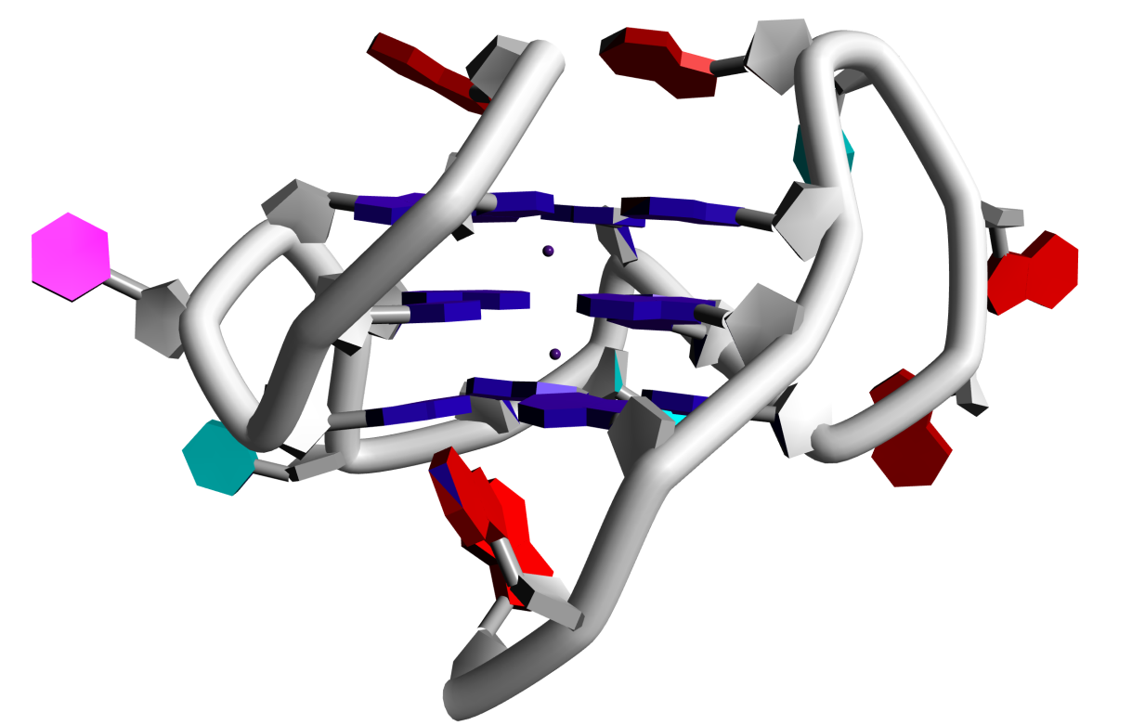
i
j

Slide 11
Figure for Box 2

Slide 12
Figure 4
a
b

