Slide 1
Self-Management Intervention Improves Behavioral Activation in Adolescents and Young Adults with Sickle Cell Disease
Anna Hood PhD, Cara Nwankwo BA, Katie Kidwell PhD, Naomi Joffe PhD, Emily McTate PhD and Lori Crosby PsyD

Slide 2
Financial Disclosures
No financial conflicts of interest

Slide 3
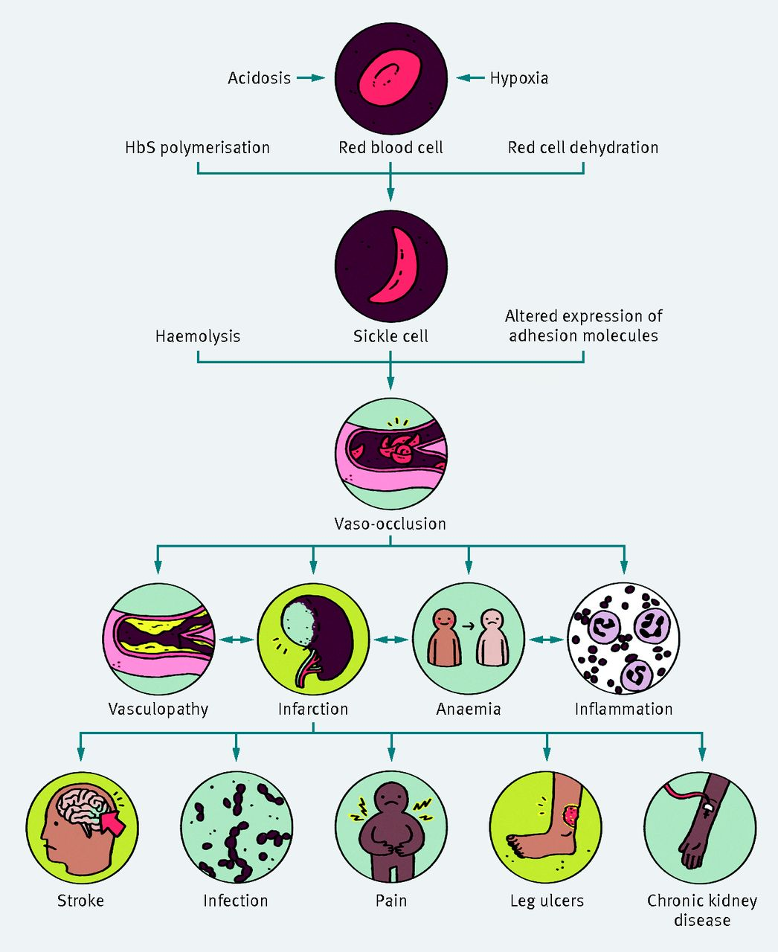

Slide 4
Self-Management
health behaviors and related processes that patients and families engage in to care for a chronic condition
Self-management has been cited as a critical concern for adolescents and young adults with sickle cell disease
Modi AC, Pai AL, Hommel KA, Hood KK, Cortina S, Hilliard ME, et al. Pediatric self-management: a framework for research, practice, and policy. Pediatrics. 2012;129(2):e473-85.
DeBaun MR, Telfair J. Transition and sickle cell disease. Pediatrics. 2012 Nov 1;130(5):926-35.
Notes:
Self-management which has been identified as a critical concern for AYA with SCD. As patients approach young adulthood, the disease worsens, their responsibility for managing the disease independently increases, and they must transition to the adult healthcare system. As a result, many AYA with SCD do not receive the preventive care they need and may not have developed the skills to independently manage what has become a more severe disease. This culminates in high rates of morbidity and mortality for these young adults.

Slide 5

Notes:
We call our study SCManage

Slide 6
Trial Description
2-Arm randomized clinical controlled trial
  Arm 1 → SCThrive - group-blended online in person
  Arm 2 → SCHealthEducation - individual phone calls
Participants randomized based on:
  Age: 13-17 vs 18-21
  Disease Severity: Severe vs Non- Severe
    * Severe→ >3 hospitalizations for pain episodes in the last 3 years; stroke; OR acute chest syndrome
Notes:
We tested the intervention in a randomized trial against an attention control condition which we call SCHealthED

Slide 7
Study Consort

Slide 8
Participant Characteristics
 | SCHealth Education | SCThrive
Mean (SD)
Age (years) | 16.3 (2.5) | 16.7 (2.3)
Range | 13 – 21 | 13 – 21
Hospitalizations | 1.81 (4.0) | 1.73 (3.5)
Emergency room visits | 2.1 (3.0) | 2.1 (2.3)
HRQOL | 52.0 (12.3) | 65.1 (14.2)
N (%) | 27 (51) | 26 (49)
Gender
Female | 14 (52) | 14 (54)
Male | 13 (48) | 12 (46)
Race/ethnicity
African-American | 27 (100) | 26 (100)
Mother’s Education
7th – 9th grade or less | 1 (3) | 1 (4)
9th – 12th grade or less | 3 (11) | 3 (12)
High School Graduate | 10 (37) | 4 (15)
Some College or Certification | 5 (19) | 6 (23)
College Graduate | 4 (15) | 8 (31)
Graduate or Professional Degree | 4 (15) | 4 (15)
Notes:
Stratifed on disease severity (e.g., stroke, ACS, pain) and age

Slide 9
Quantitative Outcomes (N = 53)
Assessed behavioral activation and self-management at baseline and post intervention
Measures
  Patient Activation Measure (PAM-13) - behavioral activation
  Transition Readiness Assessment Questionnaire (TRAQ-5)
  UNC TRxANSITION Scale
Notes:
Self-management behaviors did not differ between the groups from baseline to posttreatment, p > .05.

Slide 10
SCHealthEducation
Booster Session
Review and ACA, Insurance
7 session
Individual educational phone calls
What is Sickle Cell Disease?
It’s in the Genes
SCD Complications
Treatments for SCD
Healthy Living with SCD
Navigating Health Insurance
Notes:
SCHealthEd are 7 individual phone calls where the interventionist provides health education information

Slide 11
SCThrive
Booster Session
Planning for the Future
7 session
mixed online and in-person
group self-management intervention
complementary mobile app - iManage
Sickle Cell Disease 101
Communication &
Problem Solving
Pain & Mood Management
Mind Management
Health Management Part 1
Managing Emergencies
Health Management Part 2
Decision Making
Notes:
We developed a 7 session intervention to teach AYA with SCD skills to manage their disease with the hopes that they would have a more successful transition to adult care and better health outcomes

Slide 12
Weekly Session Schedule
Week (Location) | Agenda | Objectives | Behavioral Activation (BA)
1 (in-person) | Introduction to SC Thrive SCD knowledge | Describe their role in managing SCD Identify at least two SCD problems 2 self-management strategies | Knowledge, Self-Efficacy, Readiness for Change, Family/Social Support
2 (in-person) | My Team section of Patient Profile Introduce and practice communication skills Introduce and practice problem solving | Discuss ways to communicate about SCD to others Describe the steps to problem solving | Skills, Self-Efficacy, Family/Social Support
3 (online) | Gate Control Theory of pain My Pain section of the Patient Profile Pain management – Progressive Muscle Relaxation (PMR) and abdominal breathing Introduce pain diary Mood management – pleasant activities and imagery | Discuss the gate control theory of pain Describe ways to manage pain and fatigue Describe ways to manage strong emotions Make a weekly action plan | Mood, Self-Efficacy, Skills, Family/Social Support
4 (online) | Daily Life section of Patient Profile Distraction techniques, Guided imagery Positive thinking | Discuss the gate control theory of pain Describe ways to manage pain and fatigue Describe ways to manage strong emotions | Self-Efficacy, Skills, Family/Social Support
5 (online) | Self- Management section of Patient Profile Managing SCD symptoms, emergencies, treatments Action plan and using the iManage app for reminders and to get support from group members if taking medications | Discuss SCD symptoms, manage SCD symptoms; how to manage a health emergency Define treatment adherence | Knowledge, Skills, Self-Efficacy, Resources, Family/Social Support
6 (in-person) | Future Vision section of Patient Profile Decision making Healthy lifestyle habits (e.g., water, exercise, sleep, healthy eating) | Describe the steps to decision making Discuss water intake, exercise, sleep, diet Discuss healthy eating guidelines | Skills, Knowledge, Self-Efficacy, Resources, Family/Social Support
Booster (in-person /online) | Transition section of the Patient Profile Planning for healthcare transition SCD Review (Jeopardy Game) Planning to maintain changes | Describe at least 3 self-management tools Discuss how to manage SCD Ways to maintain changes | Self-Efficacy, Readiness to Change, Family/Social Support

Slide 13
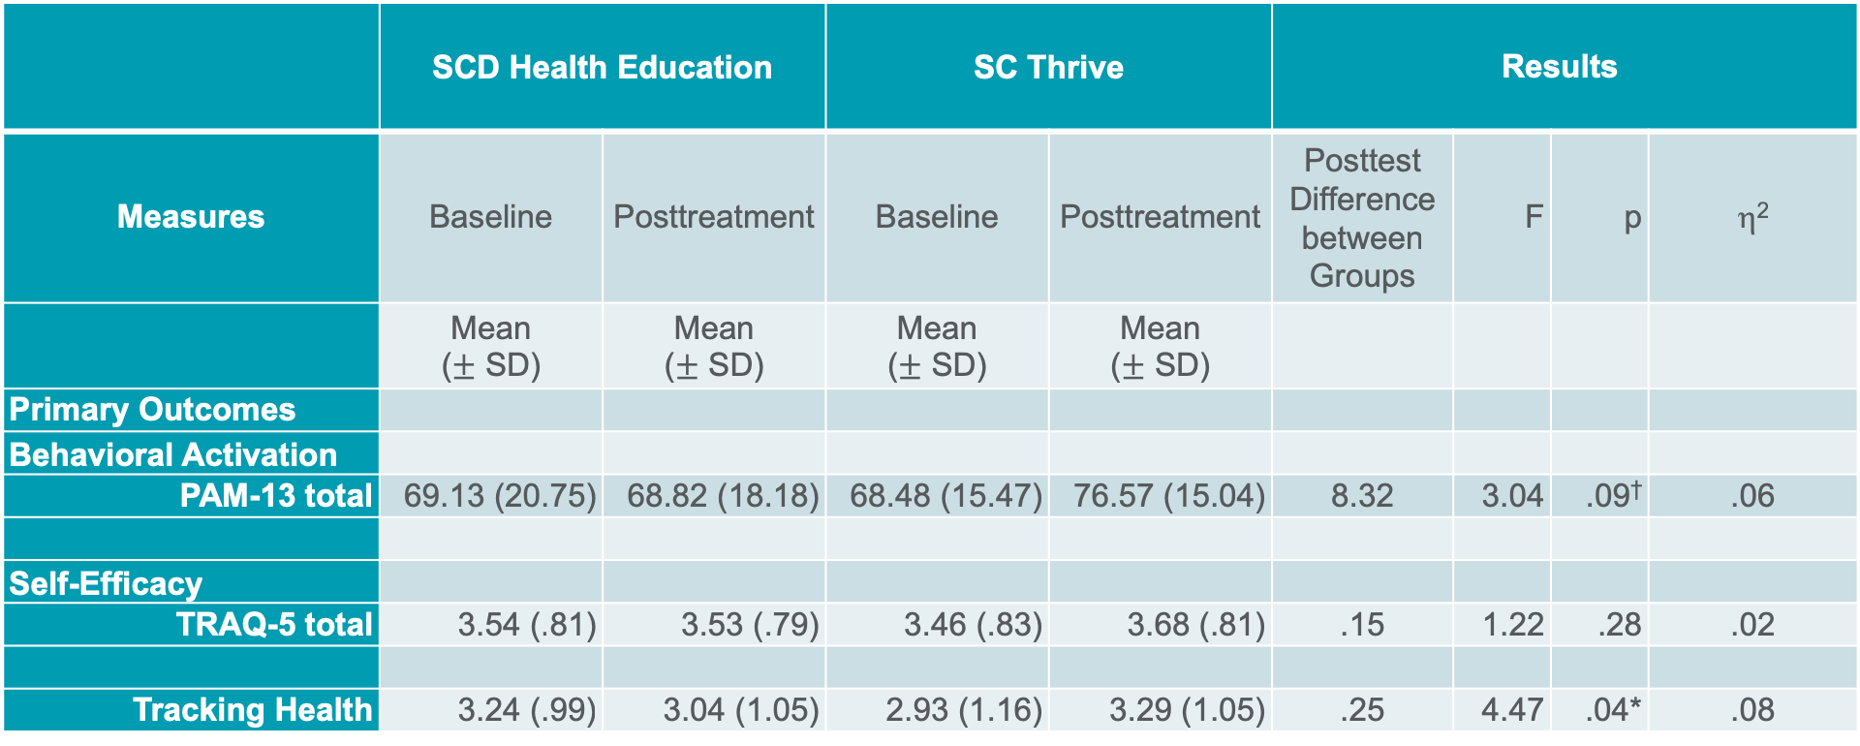
Primary Outcomes
 | SCD Health Education |  | SC Thrive |  | Results
Measures | Baseline | Posttreatment | Baseline | Posttreatment | Posttest Difference between Groups | F | p | η²
 | Mean ($±$ SD) | Mean ($±$ SD) | Mean ($±$ SD) | Mean ($±$ SD)
Primary Outcomes
Behavioral Activation
PAM-13 total | 69.13 (20.75) | 68.82 (18.18) | 68.48 (15.47) | 76.57 (15.04) | 8.32 | 3.04 | .09† | .06
Self-Efficacy
TRAQ-5 total | 3.54 (.81) | 3.53 (.79) | 3.46 (.83) | 3.68 (.81) | .15 | 1.22 | .28 | .02
Tracking Health | 3.24 (.99) | 3.04 (1.05) | 2.93 (1.16) | 3.29 (1.05) | .25 | 4.47 | .04* | .08
Increased behavioral activation​ - point = 2% hospitalization, medication adherence
No differences in self-management behaviors

Slide 14
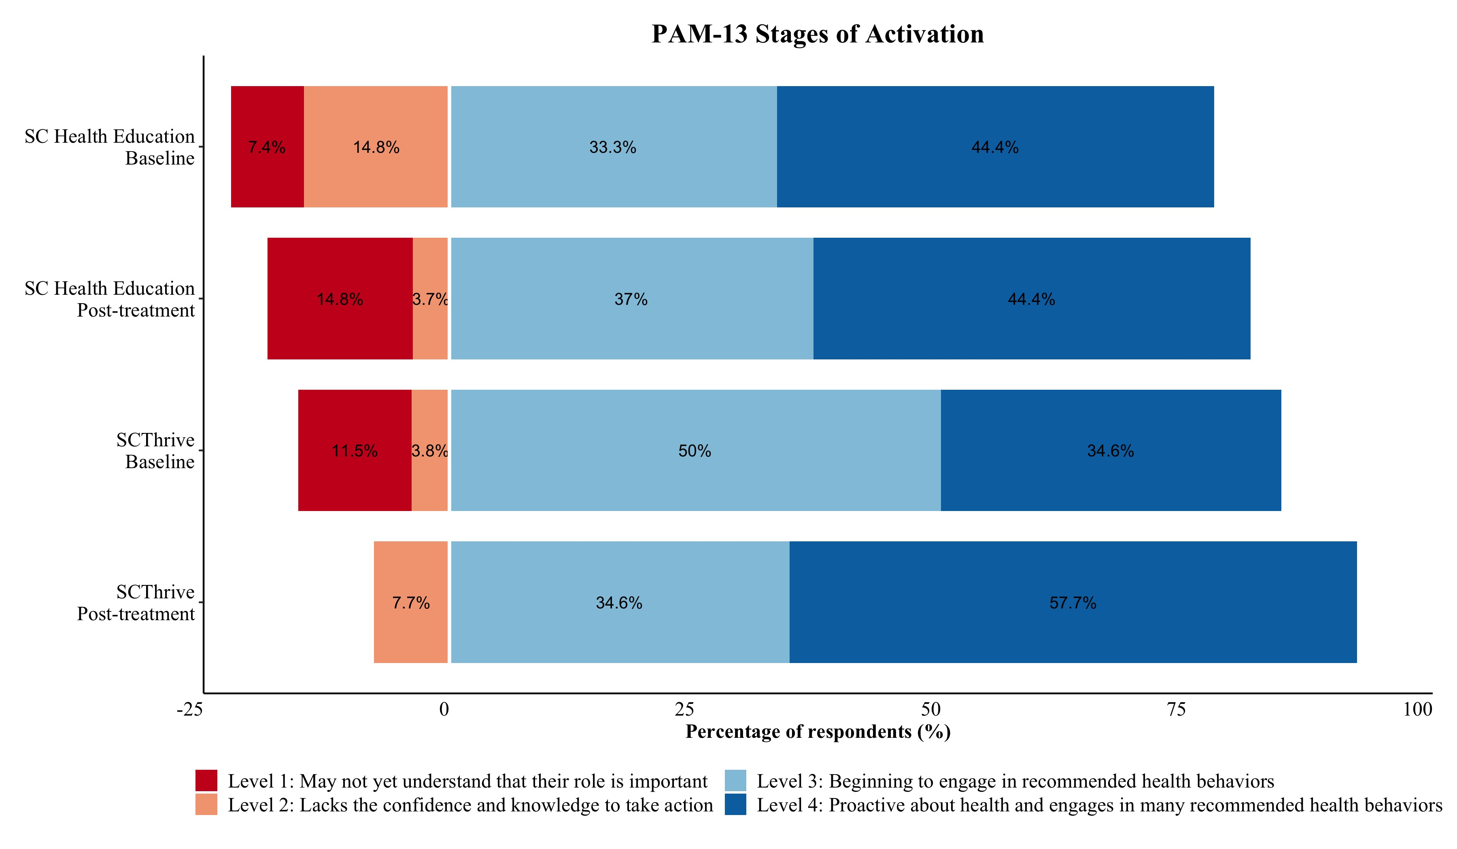

Slide 15
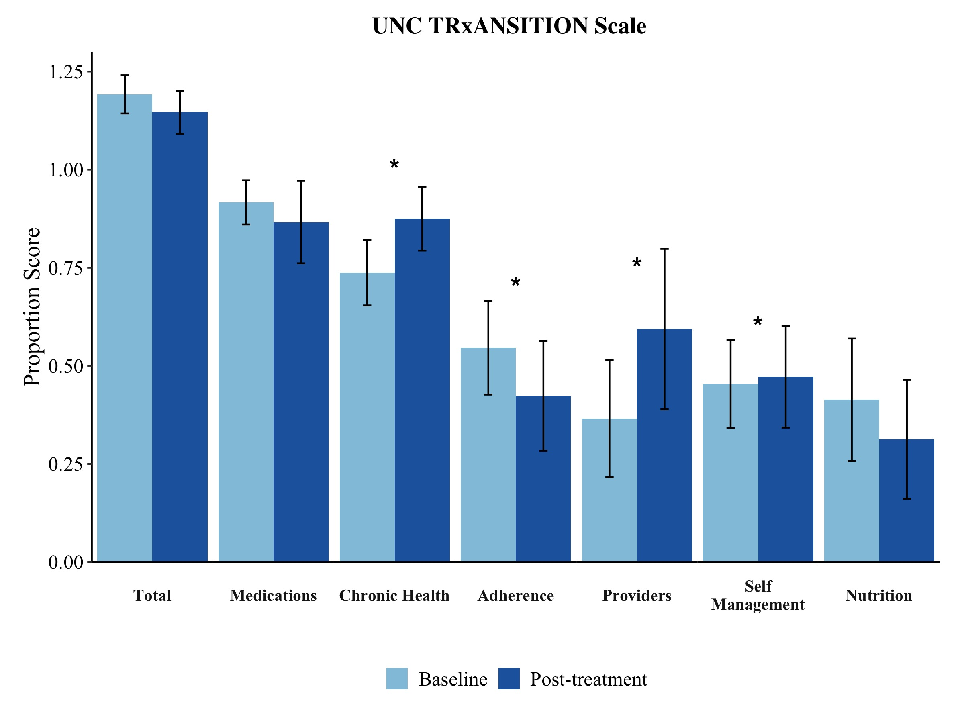

Slide 16
Weekly Evaluation Feedback
N= 26
Most liked: Action Plans, Problem Solving, and Communication Skills, Belly Breathing, Distraction techniques
Least liked: Video, Imagery scenarios, technology issues with online groups

Slide 17
SCThrive
Content
  Interesting/Informative – would recommend
  Open to trying new skills (e.g., communicating with providers)
  Enjoyed belly breathing and distraction techniques
Format
  Loved the group discussions and problem solving
  Felt less alone
  Liked the in-person booster session

Slide 18
iManage
All participants reported iManage was easy to use and beneficial for SCD management
App for phone
Messaging – 1/2
Most participants felt tracking pain, mood, and action plan progress were beneficial.
  Understanding the relationship between pain and mood

Slide 19
SCThrive
Self-management
  Managing stress, pain, and mood
  Action planning with accountability
  Staying hydrated
Helpful to include family member
Thinking about making healthy choices*
Technology issues
Video

Slide 20
The Team
Psychologists
  Lori Crosby, PsyD
  Naomi Joffe, PhD
  Emily McTate, PhD
Fellows
  Rhyanne McDade, PhD
Graduate Research Assistants
  Ashley Walton
  Heather Strong
  Davida Scoggins
  Eman Khwaja
  Cami Mosley
Undergraduate Research Assistants
  Dominique Reeves
  Kasey Harry
Clinical Research Coordinator
  Cara Nwankwo
Data Core
  James Peugh, PhD
  Christie Crosby
  Michael Taylor
  Troy Dee
Graduate Students
  University of Cincinnati
  Wright State University
  Xavier University
Notes:
It takes a village to partner with AYA to improve self-management and here is mine

Slide 21
Questions?

