Slide 1
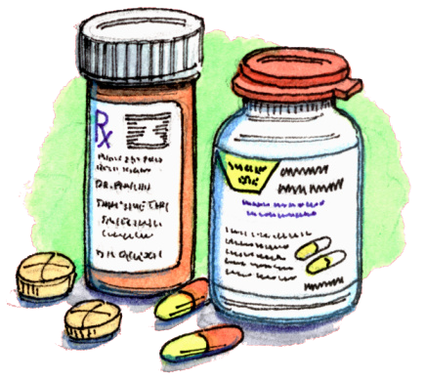
Trends in use of prescribed medicines by body mass index and age: evidence from the last two decades, using Health Surveys for England data
Shaun Scholes & Jenny Mindell
Health and Social Surveys Research Group
Research Department of Epidemiology & Public Health
Society for Social Medicine Conference, Glasgow
September 2018
Notes:
(1) Thanks to the co-authors.

Slide 2
Background
Prescribing is the most common clinical intervention in the NHS:
annual costs exceed £9billion.
Understanding differences in patterns of prescribed medicine use over time informs clinical practice and epidemiological research.

Slide 3
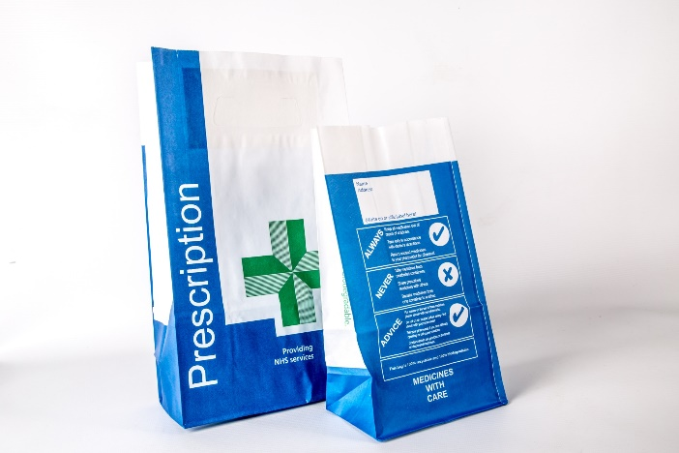
Aim
To compare trends in prescribed medicine use by obesity and age to better understand the drivers of increased prescribing.

Slide 4
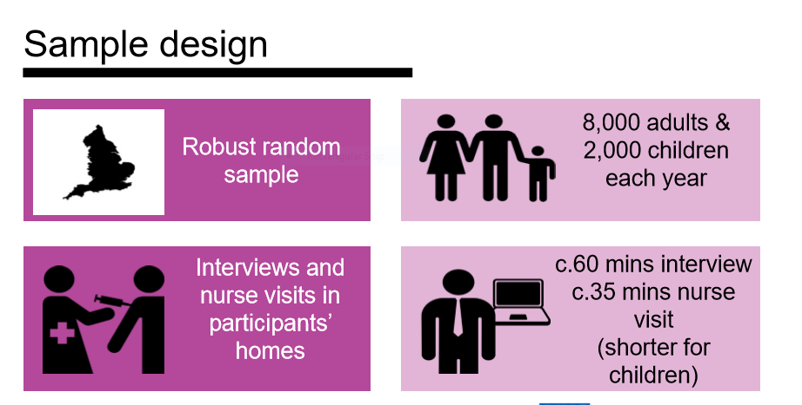
HEALTH SURVEY FOR ENGLAND
Notes:
Heard about HSE in previous presentation: collects both self-reported data and objective measurements

Slide 5
READ
HSE is….
Sampling frame = Postcode Address File
After REC approval, Advance letter, etc
Repeated cross-sectional analysis of nationally-representative Health Surveys for England 1994-2015 (N=42,216 participants aged 20+ years with measured BMI and medicine use data).

Slide 6
Data collection
At nurse visit:
Do you take any prescribed medicines?
If so:
What is it called?
Have you taken it within the last seven days?
Any other prescribed medicines?

Slide 7
Analysis
Logistic regression:
Dependent variable: Use of prescribed medicine in previous 7d
excluding contraception and smoking cessation products
Gender-specific
Independent variables: BMI status (normal weight as reference); age-group; highest educational qualification; current smoking; survey-year
Retained significant 2-way interaction terms (p<0.05): age × BMI; age × year; BMI × year

Slide 8
READ
We developed gender-specific logistic regression models with main effects and interactions between BMI, age, and survey year on taking any prescribed medicine (excluding contraception and smoking cessation products) in the last 7d, adjusting for smoking and education.
Reference for BMI: normal weight; obese: BMI ≥30kg/m²
Analyses repeated for polypharmacy (3+ medicines), and for CVD and non-CVD medicines.
Results presented as fully-adjusted Odds Ratios with 95% CIs.

Slide 9
Use of prescribed medicines in the past week: HSE 2015-16
44% of men and 51% of women surveyed reported that they had taken at least one prescribed medicine in the last 7d.
24% of men and 25% of women reported that they had taken at least three prescribed medicines in the last 7d.

Slide 10
Number of prescribed medicines taken in the last week, by BMI category and gender (age-standardised)
HSE 2015-2016

Slide 11
Prevalence of taking at least one prescribed medicine within specific medicine classes in the last week, by BMI category and gender (age-standardised)
HSE 2015-2016

Slide 12
READ
Overall, the age-standardised prevalence of prescribed medicine use between 1994 and 2014/15 increased from 38% (95%CI: 37%-39%) to 47% (45%-48%) in men and from 46% (45%-47%) to 53% (52%-55%) in women.
By 2014/15, use of 3+ medicines had doubled to 25% (23%-26%) in men and to 27% (26%-28%) in women. Among those taking any medicine, polypharmacy rose 1.7-fold to 43% (40%-46%) and 45% (43%-47%) respectively

Slide 13
Change over time in prescribed medicine use by gender
Medicine use higher among women than men

Slide 14
Change over time in prescribed medicine by age

Slide 15
Change over time in prescribed medicine by age

Slide 16
Change over time in prescribed medicine by BMI in women

Slide 17
Change over time in prescribed medicine by BMI in men

Slide 18
Any prescribed medicine, by BMI and survey year among women

Slide 19
READ
After age-adjustment, the increase in prevalence over time of taking any prescribed medicine was greatest in obese women (BMI-by-year interaction: p=0.003).
The odds of obese women taking any prescribed medicine in the last week were:
1.5 times higher than those for normal weight women in 1994 (OR: 1.49; 95%CI: 1.28-1.73), but
had increased to 2.1 in 2014/15 (2.14; 1.82-2.53).

Slide 20
Any prescribed CVD medicine, by BMI and survey year among men aged 50-59

Slide 21
READ
Increased use of CVD medicine use over time was greatest in obese men (BMI-by-year interaction: p=0.036).
The odds of obese men aged 50-59 years taking 1+ cardiovascular medicine in the last 7d were 2.1 times higher than those for normal weight men of the same age in 1994 (2.08;1.46-2.95).
The equivalent odds had increased to 3.0 in 2014/15 (2.98; 2.10-4.21).

Slide 22
Strengths and limitations
Strengths
Nationally-representative sample of free-living general population
Trends based on data from 22 years
Methods consistent over time
Limitations
Falling response rates
Limited information on indications, treatment rates

Slide 23
Conclusions
Higher BMI is associated with increased prescribing over the last 20 years regardless of age, reflecting:
secular rises in levels of awareness and of treatment of obesity and other co-morbid conditions, such as hypertension and diabetes,
increased availability of effective secondary prevention medicines (e.g. statins, ACE inhibitors),
lower thresholds for their use, and
greater adherence to guidelines for their prescription.

Slide 24
ACKNOWLEDGEMENTS
Thanks to:
NatCen staff
Interviewers and nurses for collecting data
Participants giving their time and information
Audience for listening!
s.scholes@ucl.ac.uk & j.mindell@ucl.ac.uk

