Slide 1
Theorising planning practice: The turn to viability based planning in the UK
Jessica Ferm, Mike Raco and John Tomaney
Bartlett School of Planning, UCL
AESOP conference, Gothenburg, 10-14 July 2018

Slide 2
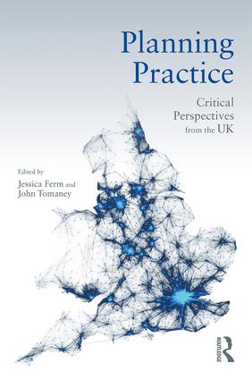
A turn to viability-based planning in the UK
“The communicative planning moment has given way to two further regime shifts; a revival of evidence-based planning and – as an extension to this – the formalisation in policy of viability- based planning. None of these regimes entirely replaces the previous, but are layered on top of previous practices, requiring new and additional expertise of practicing planners and creating greater complexity in terms of the balancing of interests and inputs into the planning process. So, planners are now required to be creative, work collaboratively, make decisions based on up-to-date evidence and be mindful of market realism in their decision and plan-making”
(Ferm and Tomaney, 2018; p.282, Chapter 18: Conclusion)

Slide 3
This paper
Exposes the controversy surrounding viability planning
Reveals how viability planning has been consolidated in the new National Planning Policy Framework & Planning Practice Guidance for England
Identifies tensions and proposes a theoretical framework of calculability to understand direction of change
Suggests that this ‘calculative turn’ poses questions for future of strategic planning & the very purpose of planning for public benefit

Slide 4
Background
UK planning system ‘discretionary’ not ‘zonal’
Local plans set out planning policy
Developers submit planning applications that are assessed against the ‘development plan’
Negotiations on a site-by-site basis to determine % of land value uplift that goes to community (e.g. affordable housing)
Financial viability assessments always done by developers, but now a ‘planning concern’.
Notes:
As Christophers (2014: 85) said “To be sure, viability always came into play. But it did so opportunistically and flexibly, not of necessity and deterministically”
Indeed, Christophers (2014) quotes a report commissioned by the then DoE, 5 years prior to the first mention of viability in policy guidance in 1998, which stated that it was ‘unrealistic to expect local planning authorities to have a detailed understanding of development economics’ (Barlow et al, 1994: 57, quoted in Christophers, 2014: 85)

Slide 5
The viability turn
Including financial viability criteria in planning policy emerged in an ‘incremental and ad hoc manner’ from 1998 onwards (McAllister, 2017)
Use of viability modelling in planning policy began in London early 2000s to demonstrate that 50% target of non-market housing was feasible (see Christophers, 2014)
Rationale for widespread adoption in policy seems to be to boost housing supply and promote development stalled by the ‘burden’ of planning obligations (McAllister, 2017: 123)
Formalised in 2012 National Planning Policy Framework
Planners to be ‘mindful of market realism’
Context of deregulation/marketisation of planning

Slide 6
“Pursuing sustainable development requires careful attention to viability and costs in plan-making and decision-taking. Plans should be deliverable. Therefore, the sites and scale of development identified in the plan should not be subject to such a scale of obligations and policy burdens that their ability to be developed viably is threatened. To ensure viability, the costs of any requirements for affordable housing, standards, infrastructure contributions or other requirements should, when taking into account of the normal cost of development and mitigation, provide competitive returns to a willing land owner and willing developer to enable the development to be deliverable”
[National Planning Policy Framework, 2012, para 173)

Slide 7
Viability in practice
Affordable housing delivery down 80% (Grayston, 2017)
Yet, debate has not focused on “the appropriateness of using calculative models… but merely the level and kind of possible future refinements to the model which had already been built” (Christophers, 2014: 88)
Clear incentives for developers, landowners & their consultants to bias calculations (McAllister, 2017; Crosby et al, 2010)
‘Selective participation that favours expert input’ and ‘black-boxing’ alienates non-experts (McAllister et al, 2016)
Existing literature on viability focuses on ‘technical issues’ in viability appraisals for plan-making and site appraisal
Notes:
in a review of 11 Council areas in England by homelessness charity, Shelter, 2,500 affordable homes were lost in one year due to viability assessments, representing 79% of the affordable homes that should have been delivered (Grayston, 2017)

Slide 8

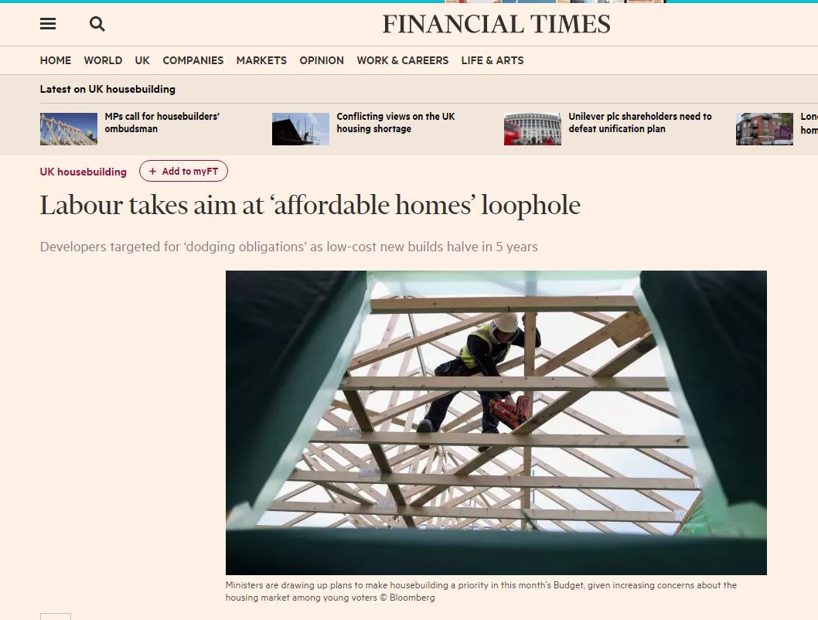
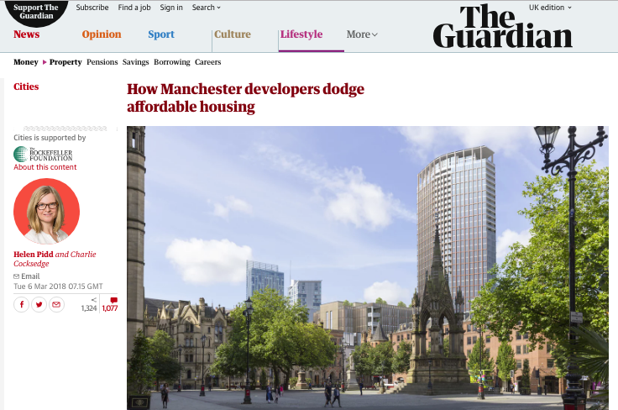
Anti-viability sentiment grows
Notes:
Public controversy centres mostly on use of viability calculations at scheme level
Referred to in the media as ‘the dark art of “viability”’
High profile cases where developers have ‘reviewed’ viability calculations to show they can no longer meet original commitments (e.g. Tottenham Hotspurs stadium (N London), requirement for 200 affordable homes ‘waived’
Heygate estate (SE London) – borough forced to disclose financial details after legal challenge

Slide 9
Reinforcing and formalising viability 2018
New draft Planning Practice Guidance 2018
‘The role for viability assessment is primarily at the plan making stage’ (p.5)
Policies (e.g. affordable housing) should be ‘set at a level that allows for sites allocated in the plan to be delivered without the use of further viability assessment at the decision making stage’ (p.4)
Assessments to be ‘proportionate, simple, transparent and publicly available’ (p.4)
Assumption of 20% GDV as ‘suitable’ return to developers for the purpose of plan making (p.10)

Slide 10
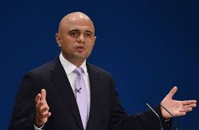
Drivers of change
Housing Secretary speech at national planning conference, 5 March 2018 promised:
“more standardised viability assessments and greater transparency. Leaving developers in no doubt of what is expected of them. In no doubt that councils will hold them to their commitments. And leaving communities in no doubt that their needs will be met”
Sajid Javid, then Housing Secretary
https://www.gov.uk/government/speeches/sajid-javids-speech-at-the-national-planning-policy-framework-conference

Slide 11
Drivers of change
Government consultation on developer contributions:
“Stakeholders have told us that the use of viability assessments in planning permission negotiations has expanded significantly. This can delay the planning process causing complexity, uncertainty and increased risk for developers. It can also result in fewer contributions for infrastructure and affordable housing than required by local policies” (para 27)
MHCLG (2018) https://www.gov.uk/government/consultations/supporting-housing-delivery-through-developer-contributions
Notes:
Transparency ‘for both developers and communities’

Slide 12
Tensions and disconnects
Front-loading at odds with (a) lack of up-to-date local plans, (b) new NPPF removes requirement for detailed local plan, (c) empirical research (e.g. McAllister et al, 2016, question workability of such an approach)
Undermines genuine public engagement at plan-making stage and alienates civil society groups and citizens who have to engage with planning-by-numbers and calculations
Shift to output-centred forms of accountability & re-aligning of public interests with private sector development
Shift to plan-making stage - major developers in a structurally advantaged position – they become ‘co-producers’ of the built environment

Slide 13
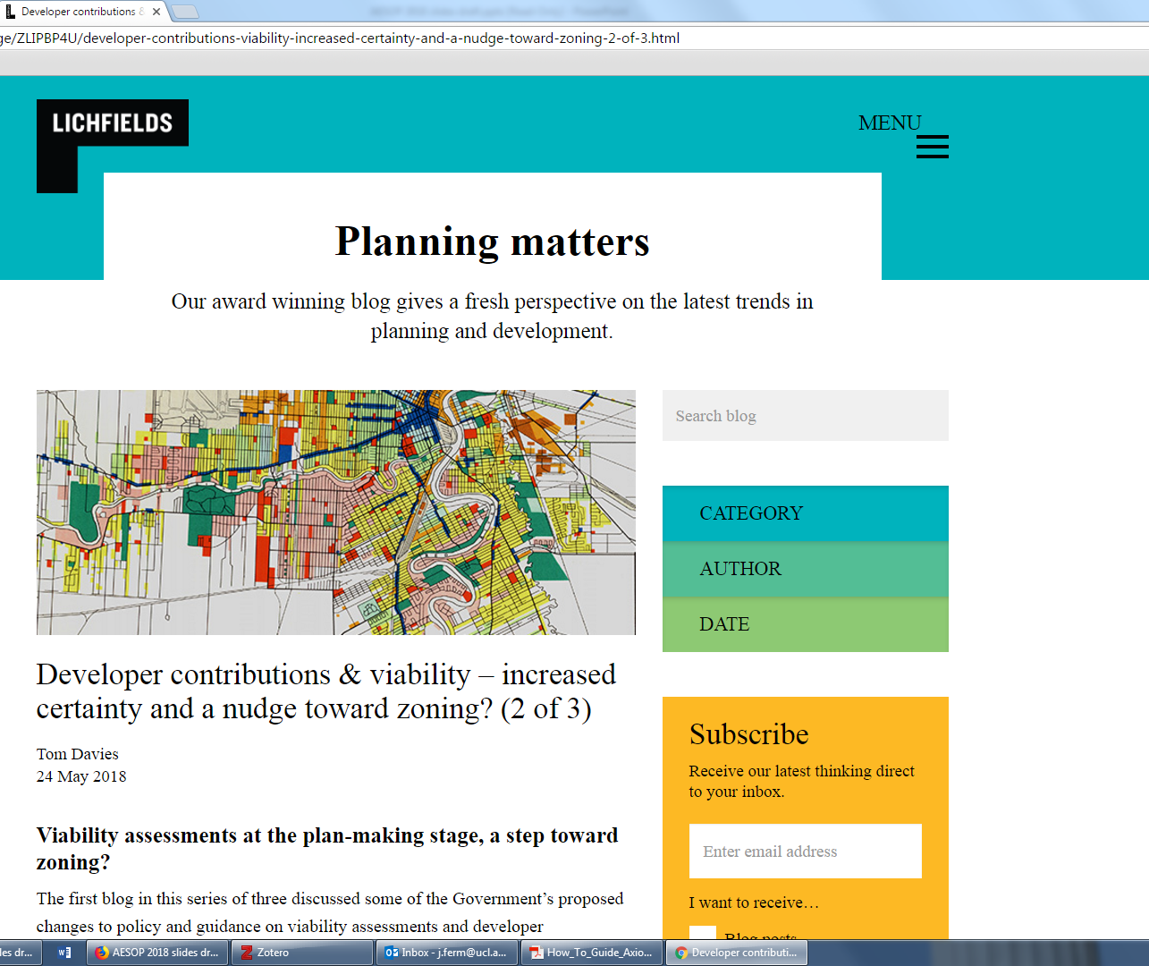
“this zoning-type approach could also help to reduce some of the risk associated with development, levelling the playing field for smaller developers”

Slide 14
Uneven geographies and outcomes
Assumption of 20% return – based on buoyant property markets – how did this come about?
McGuinness et al (2018) – criticise ‘one size fits all’, ‘spatially blind’ approach in NPPF – ignores place-based nuances in local and regional land and housing markets
Reimagining of planning around the need for and needs of successful places
Planning system being subordinated to the needs and desires of large developers in the south east of England
Research agenda

Slide 15
Understanding the viability turn
Christophers (2014): the performative nature of economic models – as ‘an active force transforming its environment, not a camera passively recording it’ (MacKenzie, 2006: 12), is applicable to viability calculation models
Models have shaped outcomes and led to homogenisation
Human actors ‘have more and more been reduced to the passive role of simply feeding data into the models in question’ (p.81)
The rise of a ‘new technocracy’ (Raco and Savini, 2018) and the insertion of private sector priorities and expertise into the heart of planning governance

Slide 16
Planning and calculability
Calculability = ‘the situated use of financial numbers’ and the ‘collaborative processes which make possible the assignment of numbers to entities’ (Vollmer et al., 2009: 623)
Based on principles of commensuration or the ‘transformation of different qualities into common metrics’ (Espeland and Stevens, 1998: p.314)
In viability planning, rather than create a common language, it ‘serves to exclude those without the quantitative skills necessary to evaluate modelling procedures’ (McAllister et al, 2016) and ‘reconfigures subjective and contestable judgments as pseudo-scientific’ (McAllister, 2017: 122-123)
The power of ‘assumptions’ in shaping calculations
Notes:
Commensuration = the comparison of different entities according to a common metric
NEED TO GO BACK TO Christophers (2014) and McAllister et al, 2016 for discussions of calculative practices and economic performativity. Show we’ve engaged with that literature.

Slide 17
Conclusions
Viability Planning uses calculative practices to systematically disentangle the complexity of places and convert them into manageable spaces ripe for development
Represents a calculative turn although one that is potentially ‘fraught, complicated, unsettled, and…surprising consequences intended or otherwise’ (Ouma et al., 2018: p.7)
Undermines potential to imagine alternative futures
Does not take into account place-based nuances
The very ethos of what the planning system is for is being reimagined and remade
Traditional skills and knowledges of planners out of date?
Notes:
Commensuration = the comparison of different entities according to a common metric
NEED TO GO BACK TO Christophers (2014) and McAllister et al, 2016 for discussions of calculative practices and economic performativity. Show we’ve engaged with that literature.

Slide 18
Documentary sources All from the Ministry of Housing Communities and Local Government (previously DCLG):
National Planning Policy Framework, 2012
Viability planning practice guidance, 6 March 2014
Select committee on the Built Environment report, Building Better Places, 2016
Draft revised NPPF (for consultation), March 2018
Draft Planning Practice Guidance (consultation), Mar 2018
Supporting Housing Delivery through Developer contributions (consultation), March 2018

Slide 19
References – viability appraisal models
Byrne, P., McAllister, P, Wyatt P (2011) Precisely wrong or roughly right? An evaluation of development viability appraisal models. Journal of Financial Management in Property and Construction, 16 (3), 249-271
Christophers, B. (2013) Wild dragons in the city: Urban political economy, affordable housing development and the performative world-making of economic models. International Journal of Urban and Regional Research, 30(2), 144-165
Coleman, C., Crosby, N., McAllister, P. (2012) Development appraisal in practice: some evidence from the planning system. Journal of Property Research, 30 (2), 144-165
Colenutt, R., Cochrane, A. and Field, M. (2015) The rise and rise of viability assessment. Town and Country Planning, 84(10), 453-458
Crosby, N., McAllister, P. and Wyatt, P. (2013) Fit for planning? An evaluation of the application of development viability appraisal models in the UK planning system. Environment and Planning B, 40 (1), 3-22
Crosby, N., Lizieri, C. and McAllister P. (2010) ‘Means, motive and opportunity: Disentangling the effects of client influence of periodic performance measurement appraisals. Journal of Property Resarch, 27, 181-201
Crosby, N. & Wyatt, P (2016) Financial viability appraisals for site-specific planning decisions in England. Environment and Planning C, 34 (8), 1716-173
McAllister, P. (2017) The calculative turn in land value capture, Land Use Policy, 63, 122-129
McAllister, A., Street, E. and Wyatt, P. (2016) Governing calculative practices: An investigation of development viability modelling in the English planning system, Urban Studies, 53(11), 2363-2379

Slide 20
References – other
Espeland, W., and Stevens, M.(1998) Commensuration as a social process, Annual Review of Sociology, 24(1), 313-343
Ferm, J. and Tomaney, J. (2018) Conclusions: Beyond Reflective and Deliberative Practice. In J. Ferm and J. Tomaney (eds) Planning Practice: Critical Perspectives from the UK. Routledge, pp.281-300.
McGuinness, D., Greenhalgh, P., & Grainter, P. (2018) ‘Does one size fit all? Place neutral planning policy in England and its impact on housing land supplies and local development plans in NE England. Local Economy, 33(3)
Ouma, S., Johnson, L. and Bigger, P. (2018) ‘Rethinking the financialization of ‘nature’’, Environment and Planning A, 50(3), 500-511, https://doi.org/10.1177/0308518X18755748
Raco, M. (2018) ‘Private Consultants, Planning Reform and the Marketisation of Local Government Finance’. In J. Ferm and J. Tomaney (eds) Planning Practice: Critical Perspectives from the UK. Routledge, pp.123-137.
Raco, M. and Savini, E. (forthcoming, 2018) New Technocracy in Planning.
Vollmer, H., Mennicken, A. & Prada, A. (2009) Tracking the numbers: Across accounting and finance, organizations and markets. Accounting, Organizations and Society, 34(5) 619-637
Wainwright, O. (2017) ‘The truth about property developers: how they are exploiting planning authorities and ruining our cities’, The Guardian, 17 September 2014, https://www.theguardian.com/cities/2014/sep/17/truth-property-developers-builders-exploit-planning-cities

