Slide 1
Clinical trials, data analysis, ethics and new drugs in inflammatory arthritis
Dr. Coziana Ciurtin

Slide 2
Synopsis
Clinical trials
scope
commonly used study designs
study populations
clinical trials phase I-IV
Statistical analysis
research questions
data analysis in clinical trials
Ethics
HRA and REC approvals
GCP
New drugs for inflammatory arthritis
mAbs vs. small molecules
new small molecules for RA
new mAbs for SpA
NICE guidelines

Slide 3

Clinical trials
Clinical trials are research investigations in which people volunteer to test
new treatments
interventions or
tests
as means to
prevent,
detect,
treat
manage
various diseases or medical conditions

Slide 4
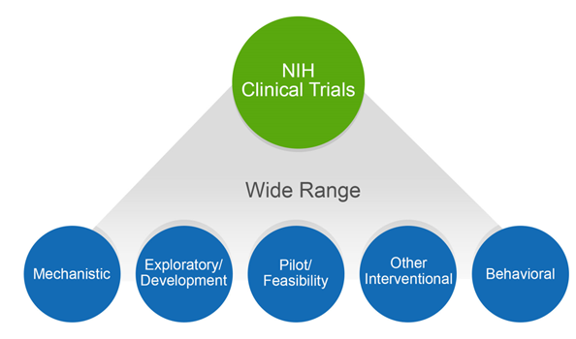
Aims to uncover a mechanism (of a disease, drug, intervention)
Small scale preliminary study conducted in order to evaluate feasibility, time, cost, adverse events, and effect size
Studies aiming at observing, describing, explaining and predicting behaviour
Exploratory research helps determine the best research design, data-collection method and selection of subjects
Interventions: medication, psychotherapy, new devices, or new approaches to surgery or radiation therapy

Slide 5
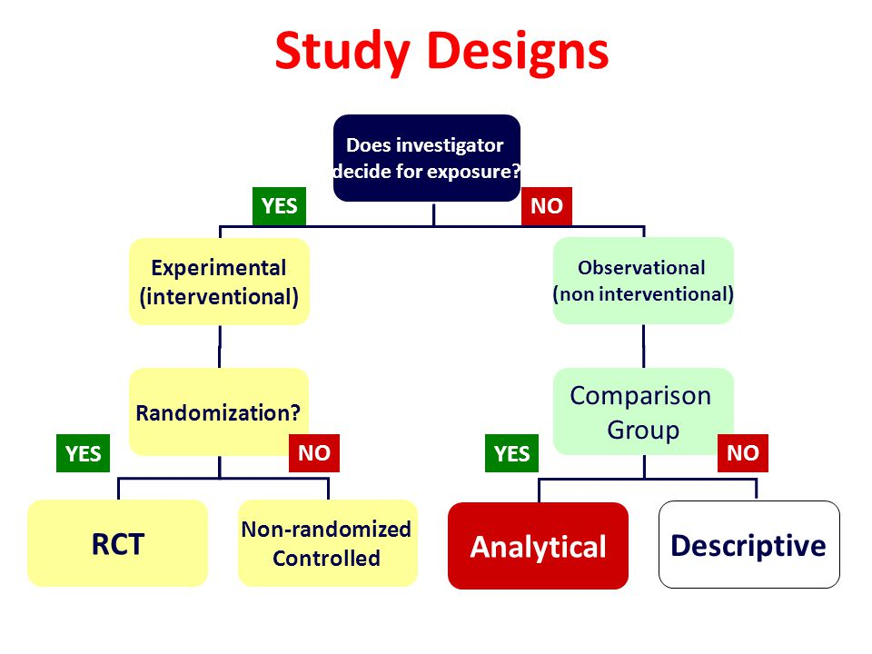

Slide 6

First clinical trial (1747)
James Lind
Studied a group of sailors
suffering from scurvy.
He placed them all on the same diet, but fed
one group with cider and vinegar and the other group lemon juice.
The group who had the lemon juice supplement recovered from scurvy in just six days.

Slide 7
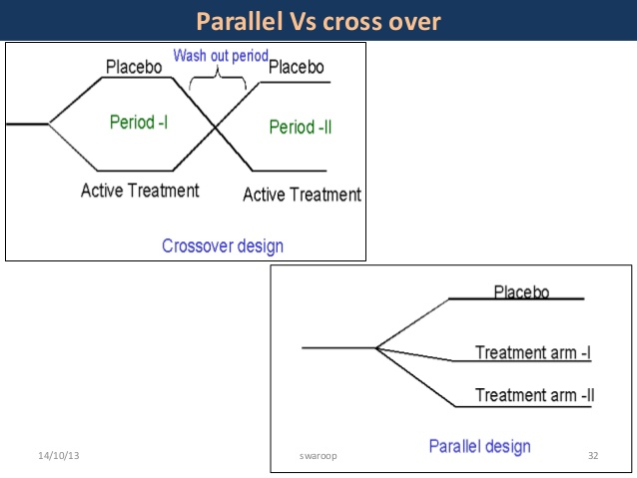

Slide 8
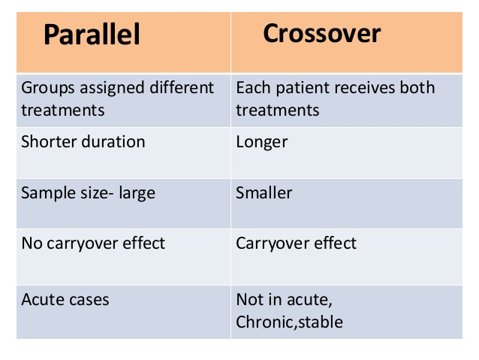

Slide 9
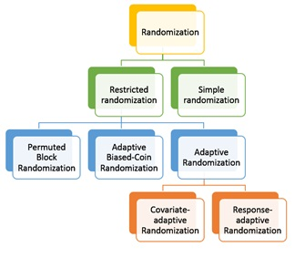
Randomization
The probability that a new subject is assigned to either group is determined by the current balance in treatment group sample sizes
e.g. AAPP, PPAA, APAP, PAPA, PAAP, APPA
The probability that a new subject is assigned to either group is determined by the current balance in: 1.baseline covariates and treatment assessment
2. response of previous patients

Slide 10
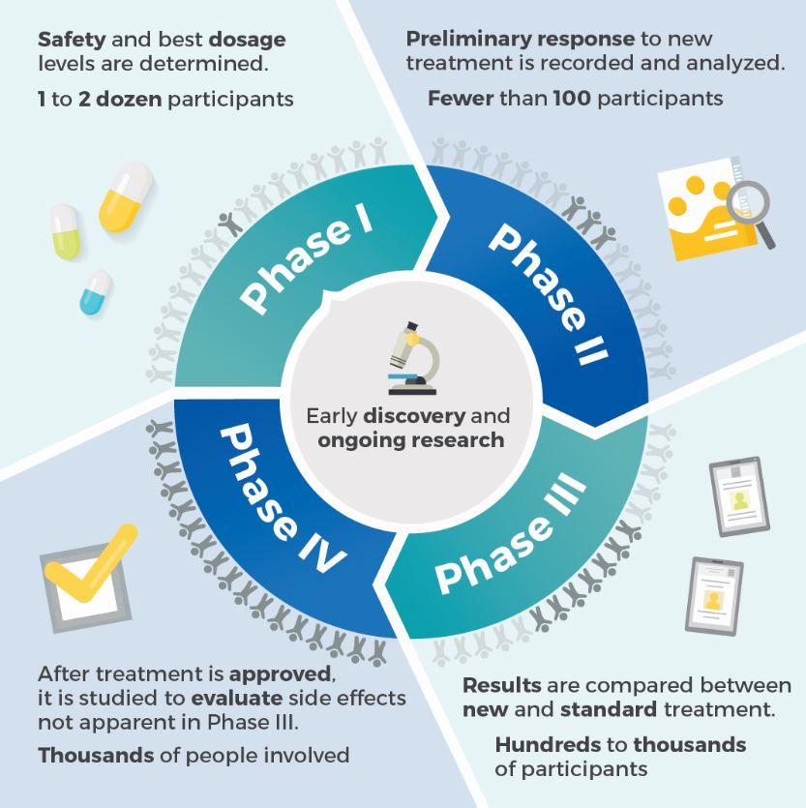
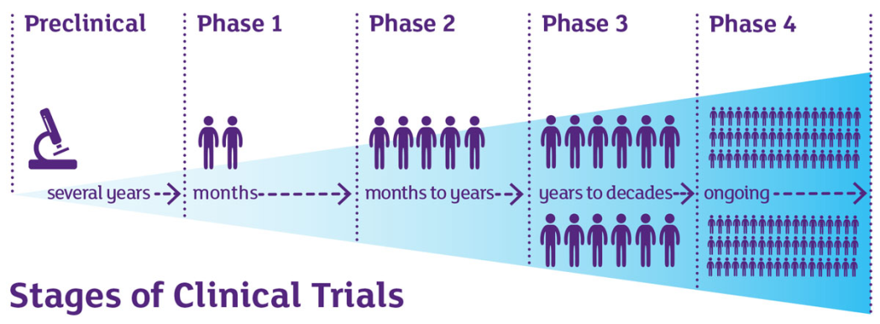

Slide 11
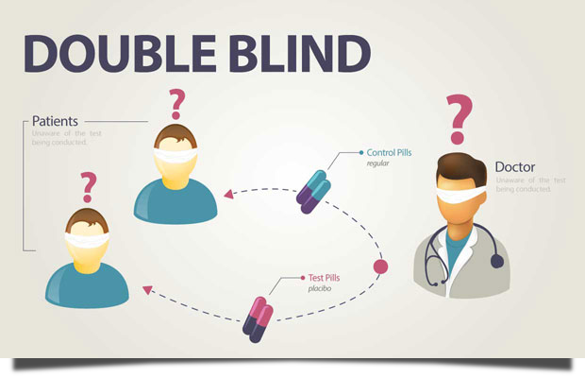

Slide 12
POPULATION TO BE STUDIED: INCLUSION & EXCLUSION CRITERIA
Achieve study objectives
Maximise safety
Minimise confounding factors whilst avoiding a totally unrepresentative patient subset
Early studies tend to have stricter criteria

Slide 13
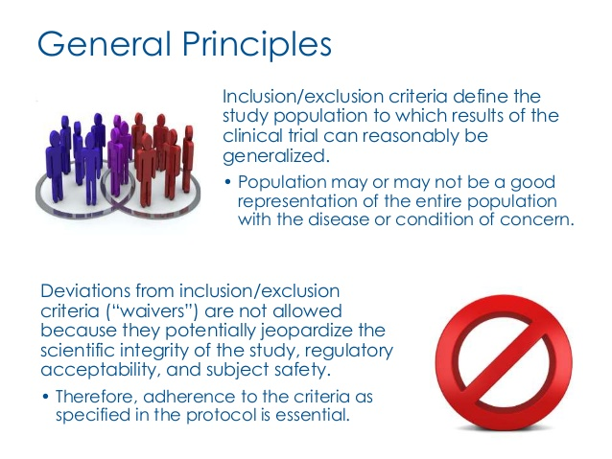

Slide 14
Quiz
A successful UK investigator of a new medicinal product plans a study to prove the efficacy of his newly discovered drug in patients with severe multiple sclerosis. A suitable study design is obligatory to include:
A. Long follow-up period
B. Cross-over design
C. Parallel design
D. Randomisation
E. Multi-national participants
Correct answer: D
The selection of a specific RCT design depends on the research question and population characteristics. There are no preset rules for the duration of study follow-up, number of sites or participants in RCTs.

Slide 15
Quiz
An UK investigator want to assess differences in response to Golimumab (50 mg vs. 100 mg) in patients with gender dysphoria and RA, compared to female RA population. Which study design would you suggest?
A. Cohort longitudinal study with 5 year duration
B. Case-control study (1:10)
C. Covariate-adaptive randomised controlled trial
D. Response-adaptive randomised controlled trial
E. The study is unethical
Correct answers: C,D
The treatment arms should be balanced according to recognised covariates likely to influence the outcome: BMI, gender, dose .
As the treatment is already available, a response adaptive trial is the most ethical option

Slide 16
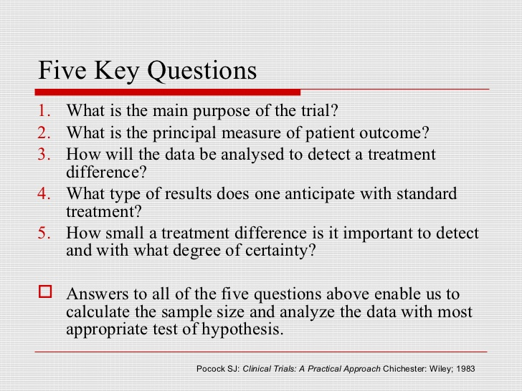
Statistical analysis for clinical trials

Slide 17
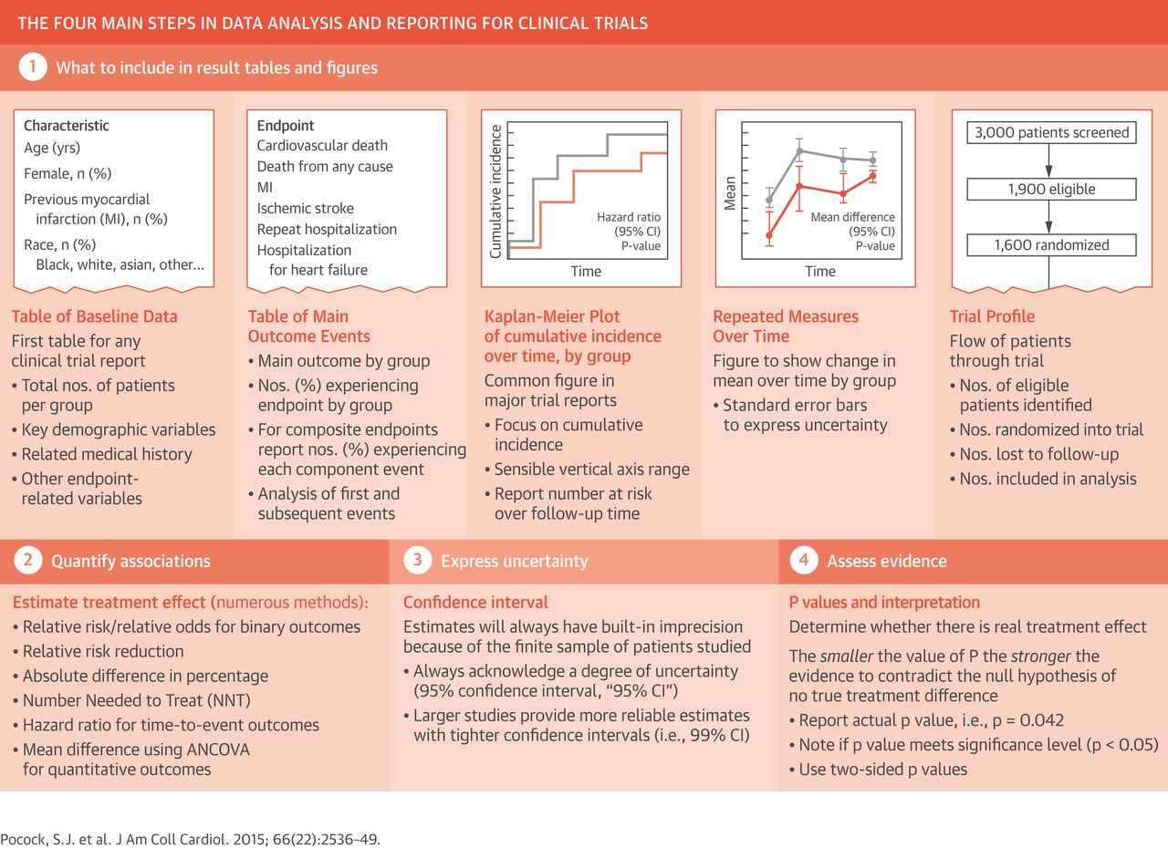

Slide 18
Quiz
A study found that out of the 100 people diagnosed with APS in country A in 1995, 20 were dead by 2000, 20 more were dead by 2005, and 20 more were dead by 2010.
A similar study in country B showed that of 100 people diagnosed in 1995, 60 were dead within 5 years.
On the basis of these figures, which of the following statements can we make
A) You have a better chance of surviving APS in country A
B) The 5-year survival rate in country B is half that in country A
C) The mortality in country B is higher than that in country A
D) The 15-year survival rate is higher in country B
Correct answer: B
Five years after diagnosis, 80 people were still alive in country A against 40 in country B. But the low 5-year survival rate in country B could be a systematic effect caused by later diagnosis; without knowing what happened in country B after 2000, we can make no comparative statement about the ultimate likelihood of surviving APS in the two countries

Slide 19
Quiz
A patient is horrified by a newspaper headline:
"A bar of chocolate a day triples your risk of arthritis".
What's the best advice you can give them?
A) tell them that this is not true
B) advise them to cut their consumption by two-thirds
C) find out what their initial risk of arthritis is and then decide what to do
D) find out how many arthritis sufferers eat chocolate and then decide what to do
Correct answer : C
Whether it's true or not, the headline portrays a relative risk. To assess your own personal response, you need to know how your absolute risk of getting arthritis in the first place, chocolate or no chocolate

Slide 20
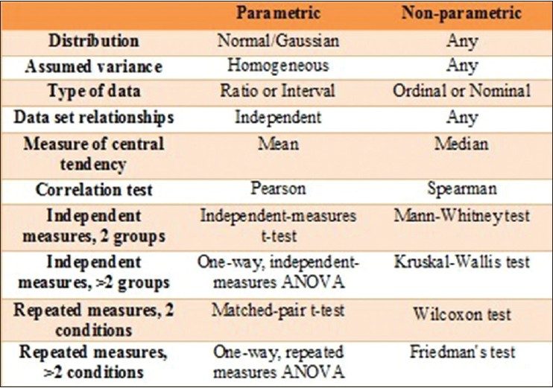
Statistical tests

Slide 21
Quiz
The nonparametric test that is analogous to the One-Way ANOVA is the:
Kruskal-Wallis test
Friedman test
Mann-Whitney U test
Wilcoxon Signed-Rank test
none of the above
Correct answers: A and B
Kruskal-Wallis test is the equivalent for independent measures in more than 2 groups
Friedman test is the equivalent for the repeated measures in more than 2 conditions

Slide 22

Clinical trials approval in England
Health Research Authority (HRA) approval is required for all project-based research that involves NHS organisations in England
It brings together the assessment of governance and legal compliance (HRA), with the independent ethical opinion (REC)

Slide 23
Examples of research that requires HRA approval
A Clinical Trial of an Investigational Medicinal Product (CTIMP) (with the exception of Phase 1 trials in healthy volunteers taking place outside the NHS)
A Clinical Investigation or other study of a Medical Device
A combined trial of an Investigational Medicinal Product and an Investigational Medical Device
A Clinical Trial to study a novel intervention or randomised Clinical Trial to compare interventions in clinical practice
A basic science study involving procedures with human participants
A study administering questionnaires/interviews for quantitative analysis, or using mixed qualitative/quantitative methodology
A study involving qualitative methods only
A study limited to working with human tissue samples (or other human biological samples) and data (specific project only)
A study limited to working with data (specific project only).

Slide 24
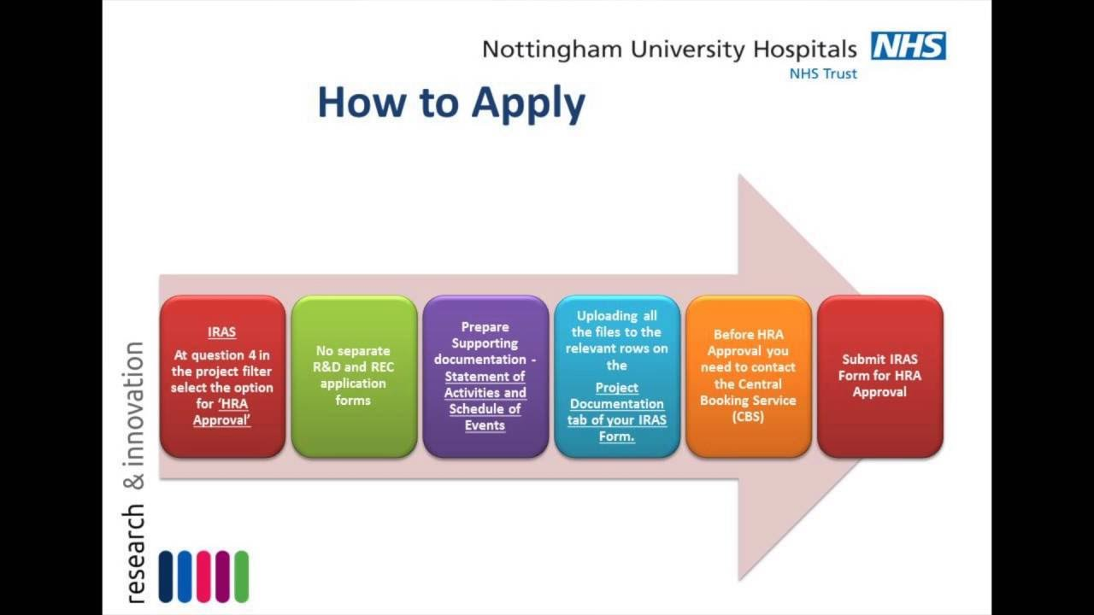

Slide 25
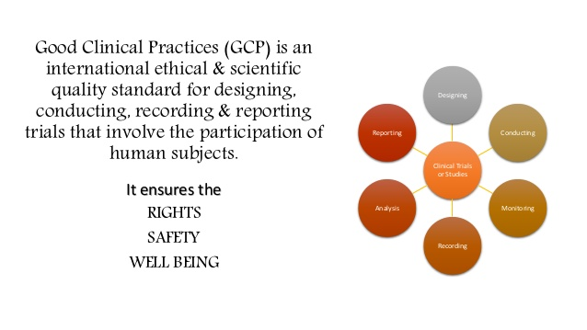
Designing
Reporting
Conducting
GCP
Analysis
Monitoring
Recording

Slide 26
Quiz
Which of the following is not always required for a clinical trial ethical approval?
Evidence that the investigational product was tested and it is safe for use in humans
A complete clinical trial protocol
Consent form
Clinical trial advertising material
Patient information letter
Correct answer: A
In some cases (phase I clinical trials), the information regarding the safety of the investigational product in humans is not available but will be generated by the clinical trial seeking ethical approval

Slide 27
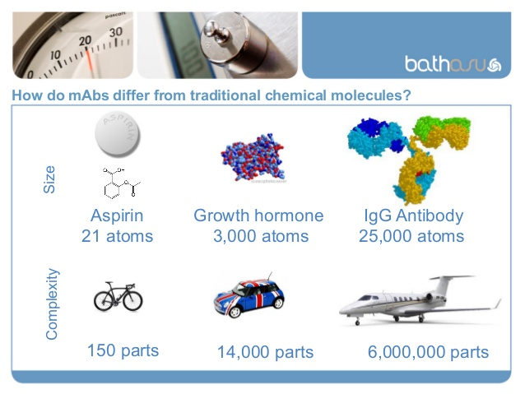
New treatments for rheumatic diseases

Slide 28
Differences:
Small molecules
Monoclonal antibodies
Small
Simple, independent of manufacturing process
Easy to characterise completely
Stable
Mostly non-immunogenic
Small molecule drug costs on average £ 0.5 per day
Large
Complex, defined by the exact manufacturing process
Cannot be characterised completely (molecular composition and heterogenicity)
Unstable, sensitive to external conditions
Immunogenic
A biological drug costs on average US £20-25 per day

Slide 29
Quiz
For a typical IgG monoclonal antibody such as adalimumab, in comparison to a small molecule drug such as ibuprofen, which of the following is not correct:
Oral bioavailability is poor
Drug distribution is target-mediated
The pharmacokinetics are more likely to be non-linear
Elimination is predominantly renal
The elimination half-life is longer than that of ibuprofen
Correct answer: D
Degradation in and poor absorption through the gastrointestinal tract prevents oral bioavailability of monoclonal antibodies. IgG is too large to be filtered at the glomerulus. Monoclonal antibodies often demonstrate target-mediated distribution and elimination. Target-mediated elimination is capacity limited (saturable) because of finite expression of the target.

Slide 30
New small molecules for IA
Medicine | Route/ dose | Mechanism | Toxicity | Indication
Apremilast/ Otezla | Titrate up to 30 mg b.d 30 mg o.d. if CKD | Selective inhibitor of PDE4 | nausea, diarrhoea, nasopharyngitis and URTI headaches, weight loss, depression, increased LFTs, cholesterol, triglycerides anaemia, lympopaenia, low platelets | PsA Similar to first line biologic Response week 16
Tofacitinib/ Xeljanz | 5 mg b.d 5 mg o.d. if CrCl<30ml/min | Selectively inhibits JAK1 and JAK3. | Abdominal pain; anaemia; cough; diarrhoea; dyslipidaemia; dyspepsia; dyspnoea; gastritis; headache; hyperlipidaemia; hypertension; insomnia; leucopenia; malaise; nasopharyngitis; nausea; peripheral oedema; pyrexia; raised cholesterol; raised liver enzymes; rash; vomiting; weight gain | RA Similar to first line or second line biologic (if patients cannot have RTX) +/- MTX Response at 6 months
Baricitinib/ Olumiant | 4 mg daily 2 mg daily in CKD Avoid if CrCl<30 ml/min | Selectively and reversibly inhibits JAK1 and JAK2. | Gastroenteritis; herpes simplex; herpes zoster (interrupt treatment); hypercholesterolaemia; nausea; thrombocytosis; upper respiratory tract infection; urinary tract infection | RA Similar to Tofacitinib +/- MTX Response at 6 months

Slide 31
Monoclonal antibodies for SpA
Medicine | Route/ dose | Mechanism | Toxicity | Indication
Secukinumab/ Cosentyx | For psoriasis/ PsA 300 mg at weeks 0, 1, 2 and 3, followed by monthly dosing from week 4. For AS patients 150 mg at weeks 0, 1, 2 and 3, followed by monthly dosing from week 4 | mAb anti IL17-A | Diarrhoea; oral herpes; rhinorrhoea; upper respiratory tract infections Conjunctivitis; neutropenia (usually mild and reversible); oral candidiasis; otitis externa; tinea pedis Anaphylactic reactions- very rare | 1st line biologic or after anti TNF failure in PsA and AS +/- MTX in PsA Response at week 16 Failed to show efficacy in Crohn’s and UC
Ustekinumab/ Stelara | For psoriasis or PsA 45 mg (body weight<100 kg) or 45-90 mg (body weight>100 kg) at week 0 and 4 and every 12 weeks afterwards | mAb anti IL12/23 (p40) | Monitor for non-melanoma skin cancer, especially in patients with a history of PUVA treatment, >60 y.o. Arthralgia; diarrhoea; dizziness; headache; injection-site reactions; malaise; myalgia; nausea; oropharyngeal pain; pruritus Depression; facial palsy; hypersensitivity reactions (possibly delayed onset); nasal congestion; pustular psoriasis | If anti TNF is contraindicated or patients failed one or more anti TNF drugs. +/- MTX in PsA Response at week 28 Also approved in Crohn’s and UC

Slide 32
Quiz
Anna has PsA and severe plaque psoriasis for 5 years. She failed MTX, SSZ and Adalimumab.
TJ = 14/68, SJ = 5/66, dactylitis affecting 2 toes and
PASI = 14 (0-72).
What treatment would do start her on and for how long would you try it:
Sekukinumab
Ustekinumab
Benepali (Enbrel biosimilar)
Cyclosporine
Apremilast
A
B

Slide 33
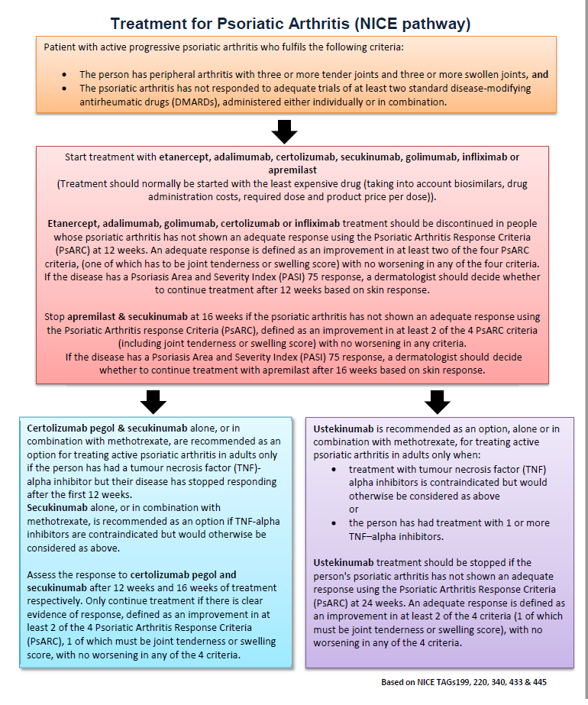

Slide 34
Quiz
James has seropositive RA with DAS 5.6.
Hx: diverticulitis, COPD, hypercholesterolaemia
He is on MTX 20 mg/weekly. Previous treatments SSZ, HCQ, Benepali and Rituximab (discontinued because of an allergic reaction). What therapeutic strategy would you go for?
A. Keep the treatment the same and review him periodically
B. Start him on Infliximab 7 mg/kg
C. add Tofacitinib to MTX
D. give him 10 mg Prednisolone/ Depo i.m.
E. Start him on Abatacept
F. Start him on Sarilumab
E
F

Slide 35
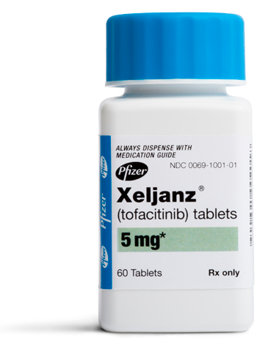
Tofacitinib in RA (TA 480)
Tofacitinib with methotrexate, are recommended as an option for treating active rheumatoid arthritis in adults whose disease has responded inadequately to intensive therapy with a combination of DMARDs, only if:
disease is severe (DAS28 of more than 5.1) and
the company provides tofacitinib with the discount agreed in the patient access scheme.
Tofacitinib, with methotrexate, is recommended as an option for treating active rheumatoid arthritis in adults whose disease has responded inadequately to, or who cannot have, other DMARDs, including at least 1 biological DMARD, only if:
disease is severe (a DAS28 of more than 5.1) and
they cannot have rituximab and
the company provides tofacitinib with the discount agreed in the patient access scheme.
Tofacitinib can be used as monotherapy for adults who cannot take methotrexate because it is contraindicated or because of intolerance, when the criteria in sections 1.1 and 1.2 are met.

Slide 36
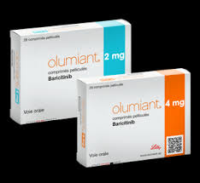
Baricitinib in RA
Baricitinib, with methotrexate, is recommended as an option for treating active rheumatoid arthritis in adults whose disease has responded inadequately to intensive therapy with a combination of DMARDs, only if:
disease is severe (a DAS28 of more than 5.1) and
the company provides baricitinib with the discount agreed in the patient access scheme.
Baricitinib, with methotrexate, is recommended as an option for treating active rheumatoid arthritis in adults whose disease has responded inadequately to or who cannot have other DMARDs, including at least 1 biological DMARD, only if:
disease is severe (a DAS28 of more than 5.1) and
they cannot have rituximab and
the company provides baricitinib with the discount agreed in the patient access scheme.
Baricitinib can be used as monotherapy for people who cannot take methotrexate because it is contraindicated or because of intolerance, when the criteria in sections 1.1 and 1.2 are met.
Continue treatment only if there is a moderate response measured using European League Against EULAR criteria at 6 months after starting therapy.

Slide 37
Sarilumab - human mAb against the IL-6 receptor (TA 485)
Sarilumab, with methotrexate, is recommended as an option for treating active rheumatoid arthritis in adults whose disease has responded inadequately to intensive therapy with a combination DMARDs, only if:
disease is severe (DAS28 of more than 5.1) and
the company provides sarilumab with the discount agreed in the patient access scheme.
Sarilumab, with methotrexate, is recommended as an option for treating active rheumatoid arthritis in adults whose disease has responded inadequately to or who cannot have other DMARDs, including at least 1 biological DMARD, only if:
disease is severe (a DAS28 of more than 5.1) and
they cannot have rituximab and
the company provides sarilumab with the discount agreed in the patient access scheme.
Sarilumab, with methotrexate, is recommended as an option for treating active rheumatoid arthritis in adults whose disease has responded inadequately to rituximab and at least 1 biological DMARD, only if:
disease is severe (a DAS28 of more than 5.1) and
the company provides sarilumab with the discount agreed in the patient access scheme.
Sarilumab can be used as monotherapy for people who cannot take methotrexate because it is contraindicated or because of intolerance, when the criteria in sections 1.1 and 1.2 are met.
The trials also showed that for treating severe active rheumatoid arthritis that has not responded adequately to conventional DMARDs, sarilumab alone is more effective than adalimumab alone.

Slide 38

Questions?

